Slide 1
The Moon Village
Concept Elements

Slide 2
Moon Village
Political and inspirational elements
1. The legacy
Women and men from many Nations have been permanently inhabiting outer space since the outset of the century on-board the International Space Station (ISS). The unique ISS environment enables scientific, technological and commercial research for the benefit of the whole humankind. ISS is now a mature enterprise on whose success we shall build to further human expansion in outer space.
ESA Member States have invested significantly to build up this expertise and they have recently confirmed that being part of “large projects” is an expectation that goes with their ESA membership.
2. A new paradigm
Space activities are undergoing a swift evolution where innovative alliances between private and public entities will play an increasingly important role. We call this new phase “Space 4.0” which occurs at the same time with other technologically pervasive revolutions such as industry 4.0 and internet of things
3. The Moon
The Moon is our cosmic neighbour and a destination of choice, in its own right, for exploration and settlement. Moreover all space exploration roadmaps include the Moon as the immediate next step from LEO on the journey to Mars. A permanent presence on the Moon would provide a tested, and possibly a springboard, for further space exploration.

Slide 3
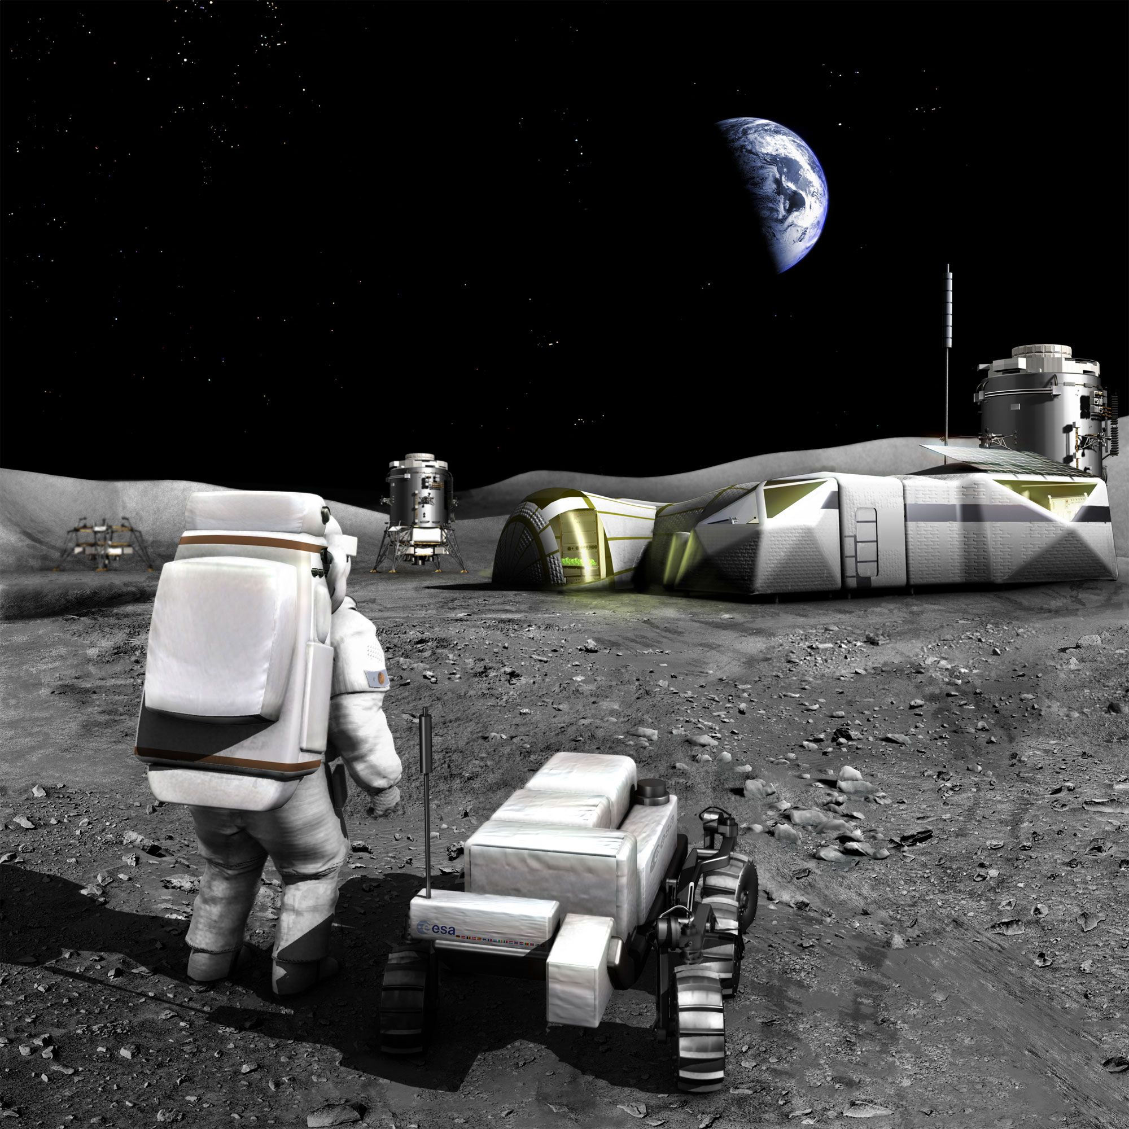

Slide 4
Moon Village
Political and inspirational elements
5. The vision of a Moon Village
The Moon Village is growing ensemble suited for multiple uses and open to multiple users. It will be served both by automatic and robotic as well as human capabilities to ensure flexibility and sustainability as well as to cater for potential contribution of all Nations. It will call for the provision of common services thus opening new markets.
The Moon Village is to incrementally evolve as an open, inclusive and sustainable endeavour to serve humankind by supporting world-class science from the Moon, novel cooperation opportunities open to all partners, opportunities for public as well as industrial and commercial players, inspiring education and cultural activities to mobilize the citizens of the World and in particular the younger generations.
The Moon village shall also serve a test bed for new governance schemes and alliances, allowing the emergence of new paradigms in science on/from the moon, new private/commercial activities (resources mining, moon products, entertainment/tourism), human/robotics interaction, involvement of general public with new immersive technologies and ways of crowd shaping for the younger generation in particular.
Its incremental evolution should allow short-term achievements within forward-looking objectives and a new narrative.
6. An initiative initiated and inspired by Europe through ESA
The Moon Village is to be regarded as an European-inspired initiative where all countries would contribute according to their capabilities and interest. While Europe cannot aim at leading such initiative, it shall create the conditions and act as a catalyst for the community of Nations to start discussing, outlining and co-developing, along with other stakeholders, the actual implementation of the vision. Europe's initiatorship should secure to our Continent a place at the forefront of technological innovation and in the geopolitics of space, promoting a model of development based on open access.

Slide 5
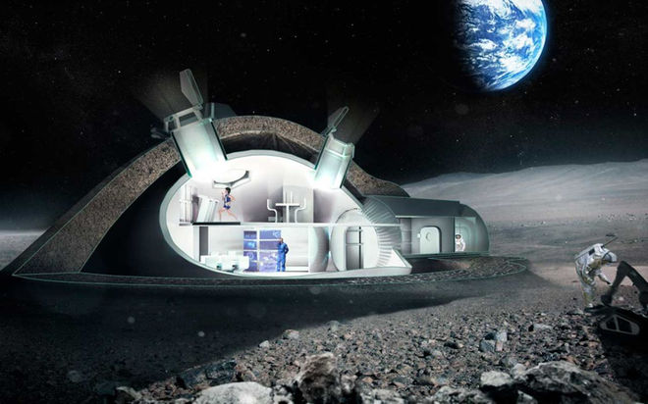

Slide 6
Moon Village
Programmatic elements
1. On-going activities
The ISS Programme and its evolution (MPCV-ESM, Deep Space Habitat study, Lunar activities – D/HRE).
The European Astronaut centre in Cologne (EAC – funded through the ISS Programme – with its Spaceship EAC initiative and work on ISRU and analogues – D/HRE)
The Aurora Exploration Programme (M2REP that could accommodate lunar activities – D/HRE);
The ESA mandatory scientific programme (relation with scientific community and call for new ideas – D/SCI);
Enabling technology activities carried out in D/TEC (e.g. Melissa, CDF, GSP).
2. An initiative across multiple areas
In a cross directorate-approach however contribution can be expected by other ESA groups (e.g. D/TIA and/or D/LAU). The members of the European Astronaut Corps (some of whom may have an active role in the implementation) are the best placed ambassadors for this endeavour with decision-makers, stakeholders and general public.
3. An exploration envelope programme
Such a programme, of which the Moon Village would be the core element, may include:
Studies on architectures, elements and operational concepts (incl. staging points in LEO)
Enabling technologies development and TRL enhancement.
Test bed activities and analogues.
Preparatory missions (automatic) and a Phase A studies for human missions.
Synergy or convergence with national initiatives (e.g. LUX on space mining) should be considered for inclusion.

Slide 7
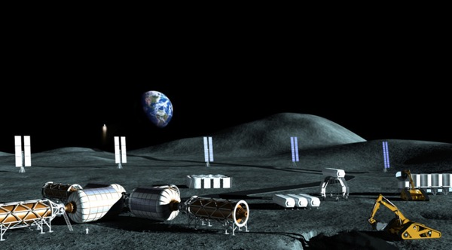

Slide 8
Moon Village
Programmatic elements
4. A new paradigm embedded in the envelope programme
In view of the novelty in the approach that is sought, such envelope programme would also encompass activities aimed at facilitating:
A closer and structured cooperation with European technical and research Universities.
The involvement of non-space industry.
Innovative partnership opportunities for commercial endeavours.
The definition of new governance principles, standards as well as of a suitable legal framework.
5. Rallying the international community and stakeholder
Member States are for ESA its natural constituency and a close interaction with them is therefore a pre-requisite. Additionally, buy-in by the broadest possible international community and stakeholders is a key feature in this endeavour. As an Europe-inspired initiative and in order to reap the benefit of Europe’s initiatorship it is important that ESA, as Europe’s voice, initiate and maintain initiative in international fora (such as ISECG for ISEF2017, UNCOPUOS for UNISPACE+50) and seize global opportunities to advance the vision rallying the support of different stakeholder groups.

