Slide 1
Smart Specialisation and Cultural Heritage: an overview
Martina Pertoldi
Smart Specialisation Platform
JRC, European Commission
Smart Specialisation and Cultural Heritage: an engine for Innovation and Growth
Roma, 25 November 2016

Slide 2
Research and innovation strategies for smart specialisation (RIS3) are ▪ integrated, place-based national/regional economic transformation agendas ▪ promoting investments in R&I as main factors for economic development in the light of Europe2020 objectives (smart, inclusive and sustainable growth) ▪ based on the concentration of resources on economic activities with high transformative potential for the regional economy ▪ through the engagement of Quadruple Helix actors in Entrepreneurial Discovery Process ▪ encouraging regions - and regional governments - to “particularise themselves by generating and stimulating the growth of new exploration and research activities” (Foray, 2015).
Smart Specialisation: the policy framework
Notes:
aiming at investing more and better in research, innovation and entrepreneurship as part of Europe's response to the present economic crisis, addressing all the Europe2020 objectives (smart, inclusive and sustainable growth)
Make choices and
And in particular economic players

Slide 3
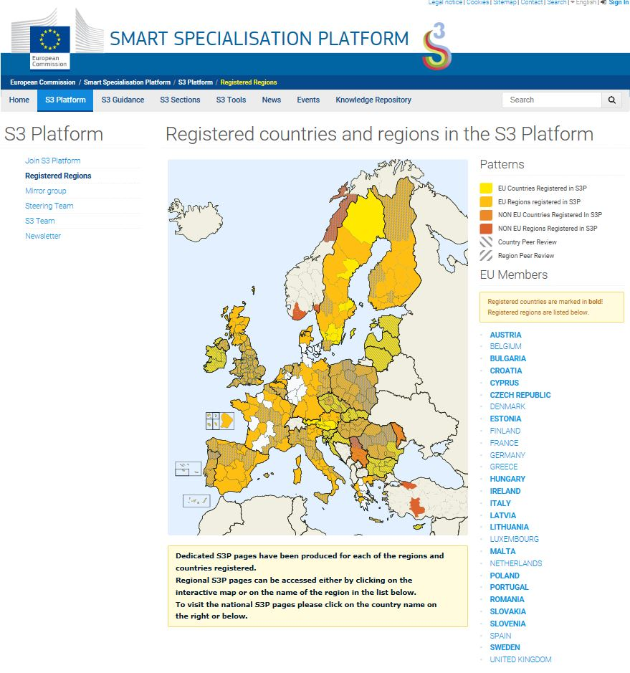
The Smart Specialisation Platform
S3P
created in 2011,
managed by the Joint Research Centre (European Commission)
Guidance - Analysis - Support
Comprehensive guidance tools:
RIS3 Guide, Digital Agenda Toolbox, FAQs
S3 Publication series:
contributing to conceptual and empirical developments of smart specialisation
Online interactive tools (e.g. Eye@RIS3)
S3 thematic Platforms on Energy, Agri-food and Industrial modernisation
Smart Specialisation Community
Wide membership: 170 regions, 18 Member States

Slide 4
Targeted support in RIS3 implementation:
the S3 thematic platforms
Support the development and enhancement of European eco-systems for interregional collaboration based on areas of smart specialisation
Facilitate the exchange of experience, mutual learning and cooperation to achieve better matching of (private/public) innovation actors, in RIS3
Better align and integrate the EU framework for innovation and investment policies to regional development, using a value chain approach.
R&D
Marketing
New Value Chain
Design
Production
Logistics
Initial Focus
Demonstration Projects (TRL6/7)
Joint Pilots
Access to new funding and
New Markets
New Products
and Services
New Value Chains
Areas of
Shared Interest
Co-funded
Joint Calls

Slide 5
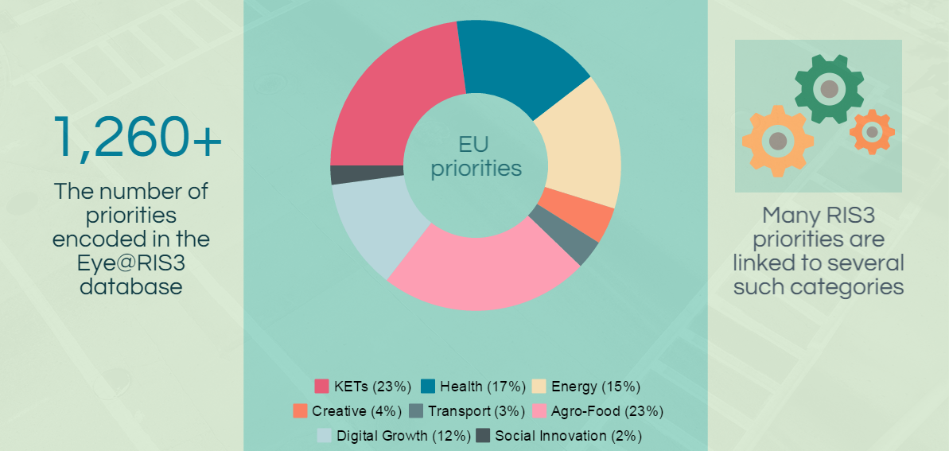
Cultural heritage in RIS3s:
the multidimensional nature of Cultural Heritage
Main RIS3 priorities
Source: Eye@RIS3 (2015)
Notes:
CH: tangible and intangible (ICOMOS, 2002)
CH: Built Environment, Natural Environment and Artefacts
In most cases site-specific and area-based
This makes difficult to catch CH within a specific category

Slide 6
49 regions with focused approach to CH
Flemish Region, Cyprus, Dytiki Makedonia,Thessalia, Ipeiros, Notio Aigaio, Kriti, Sterea Ellada, Peloponnisos, Attiki, Notio Aigaio, Galicia, Cantabria, Castilla y León, Andalucía, Pais Vasco, Iles Baleares, Centre, Nord - Pas-de-Calais, Bretagne, Pays de la Loire, Provence-Alpes-Côte d'Azur, Corse, Moldova, Podlaskie, Kujawsko-Pomorskie, Norte, Lisboa, Alentejo, Vojvodina, Värmlands län, Slovenia, Lazio, Calabria, Provincia Autonoma di Trento, Puglia, Friuli Venezia Giulia, Emilia Romagna, Veneto, Provincia Autonoma di Bolzano, Sardegna, Sicilia, Basilicata, Campania, Lombardia, Molise, Toscana, Piemonte, Abruzzo
73% Cultural Heritage as an asset for tourism and experience industry
49% Technologies for Cultural Heritage (including KETS and digital technologies)
of which
27% Technologies for sustainable built environment/SCC
24% Valorisation of culinary traditions and local food identities*
Other: Experimenting with Cultural Heritage as a field for social innovation
Language and Ethnicity
* Different from typicity in Agri-food
Italy (17/21 regions), Portugal (4/5), Greece (9/13)
Cultural Heritage in RIS3s:
sample analysis based on priority description
Source: Eye@RIS3 (2016 – to be published)
Notes:
(starting from 19 regions with an explicit priority in Cultural Heritage)
37% Tourism + construction/smart city/sustainable living
22% Tourism + construction/smart city/sustainable living + Digital Agenda

Slide 7
Smart Specialisation and CH: main challenges
Shift from current economic performance to development potential based on competitive advantages, emerging demand and societal challenges, incl. external perspective
No top-down decision, but dynamic entrepreneurial discovery process bringing stakeholders together around a shared vision
All form of innovation,
technological as well as practice-based and social innovation (from technology to humanities)
Support for value chains, rejuvenating traditional sectors through higher value-adding activities, cross sectoral links, new market niches by co-invention
Policy delivery: concentration of financial and entrepreneurial resources for structural change
Product/process innovation as well as system innovation (the key role of the public sector)
Mobilisation of investments and synergies across different funding, departments and governance levels (EU/national/regional/local)
Notes:
Identifying niche activities able to produce a structural change
Assessing local development potential.
Mapping existing and potential dynamics of change.
Mapping the links between cultral activities and the wider economy.
Entrepreneurial discovery process
Who are relevant stakeholders and agents of change? What is the added value of this specialisation? Is it a cross-sectoral activity or a niche activity?
Mapping capabilities/expertise in the region and outside the region.
Need to involve different professional communities
Bring together the relevant local actors and jointly explore possible collaboration in the prioritised niches of growth.
Network local stakeholders with external scientific and entrepreneurial knowledge on the basis of local needs and resources.
Identify complementary investments associated with the priority.
Project calls and selection criteria: individual projects (a chance to be) vs the resulting pattern of change

Slide 8
Thank you!
Smart Specialisation - S3 Platform
http://s3platform.jrc.ec.europa.eu
martina.pertoldi@ec.europa.eu

