Slide 1
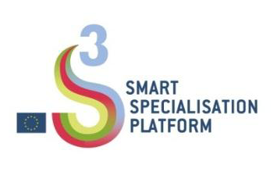
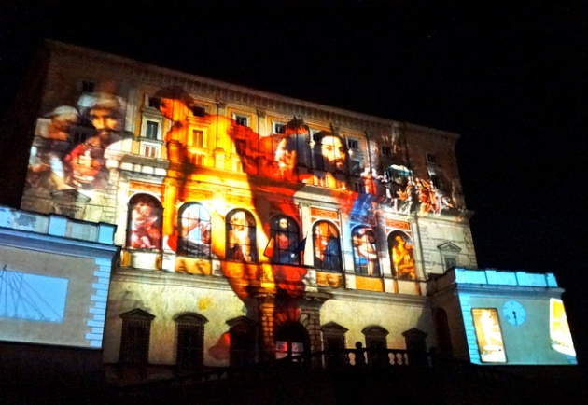
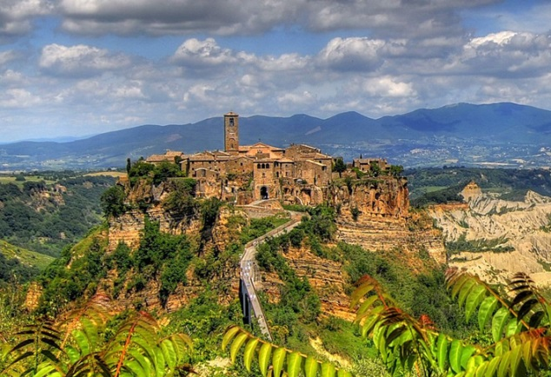
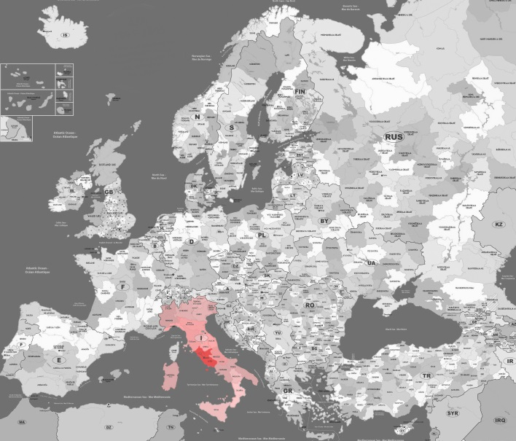


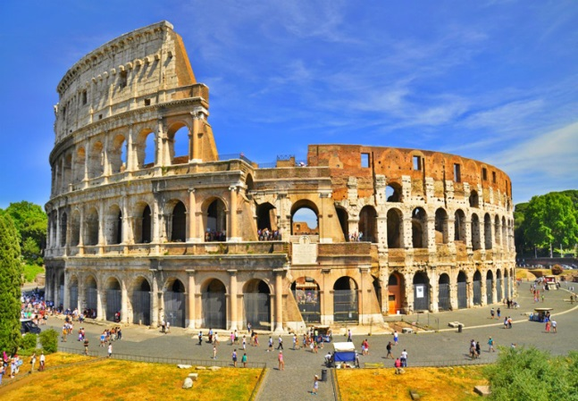
CULTURAL HERITAGE
An engine for innovation and growth – S3 Platform peer review
Rome, 25th November 2016
Working groups
Connecting actors and policy instruments for innovation
REGION of LAZIO

Slide 2
CULTURAL HERITAGE. An engine for innovation and growth – S3 Platform peer review
(Rome, 25th November 2016)
Open issues
Business models:
Innovation:
Interregional and international
cooperation:
How to encourage more effective models of public-private cooperation?
What role can public sector demand play, with tools such as Pre-Commercial-Procurement?
How can new technologies help to raise the use made of cultural resources?
How can contamination between the humanities and digital sciences serve as a basis for broadening the range of products and services in the sphere of cultural heritage promotion and development?
How to promote interregional cooperation in Europe among S3 specialisation areas in order to facilitate the sharing of experiences and increase cooperation in the areas of research, innovation and commerce?

Slide 3
CULTURAL HERITAGE. An engine for innovation and growth – S3 Platform peer review
(Rome, 25th November 2016)
MIRIAM CIPRIANI
Regional director of Culture and Youth Policy

Slide 4
CULTURAL HERITAGE. An engine for innovation and growth – S3 Platform peer review
(Rome, 25th November 2016)
Forthcoming actions
Valorization in the Lazio Region
Historically, efforts to promote and develop cultural assets have been made in single initiatives, chiefly in the sphere of preservation.
Today the priority goal is to improve the use made of places of culture and to raise the «supply» of cultural assets and cultural tourism demand, through:
  Process innovation
  Product innovation
Notes:
Innovazione di processo e innovazione tecnologica applicata ai beni culturali
Piani di gestione
Immagine coordinata

Slide 5
CULTURAL HERITAGE. An engine for innovation and growth – S3 Platform peer review
(Rome, 25th November 2016)
Forthcoming actions
Process Innovation
  Identification of management models (Ex .: the site management plan UNESCO Tarquinua / Cerveteri extended to the Archaeological Park of Vulci; identification of program manager of the tenders)
  Social participation in the innovation process (the JAM Regeneration Foundation City: Marathon proposals for urban regeneration in social and open innovation point of view; Mobile Video Contest Info Point; Creativity Jam for Civita # J4C)
  inter-institutional collaboration agreements (Ex .: Memorandum of Understanding between 17 municipalities of the North Via Francigena)
  Establish partnerships, including international ones (Ex .: from CERTESS URBAN MANIFACTURING - Cte Interreg Europe)
Notes:
Metodo: azioni di valorizzazione che integrano la gestione dei beni, dei servizi e prevedono il coinvolgimento di tutti i livelli di governo del territorio

Slide 6
CULTURAL HERITAGE. An engine for innovation and growth – S3 Platform peer review
(Rome, 25th November 2016)
Forthcoming actions
Product innovation: the integrated enhancementes systems
City Foundation as contemporary places (Rationalist architectural heritage)
Paths of Spirituality (Via Francigena, Cammino di Benedetto, Cammino di Francesco);
Cities of Etruria (in particular UNESCO site of -Cerveteri Tarquinia and Vulci Archaeological Park)
Tivoli Villas (UNESCO sites of Villa Adriana and Villa D'Este, Villa Gregoriana and the Sanctuary of Hercules Victor)
Ostia Antica and Fiumicino
Appia Antica (Lazio route from Rome to Minturno)
Notes:
Prima del bando: Info Point Mobile per la via Francigena: Video Contest: finalizzato a raccogliere proposte per nuove modalità di fruizione degli itinerari della via Francigena da realizzare con video di massimo 3 minuti. Tre progetti premiati: ApePoint Francigena; Eco-Infopoint Mobile; ApeCar Francigena

Slide 7
CULTURAL HERITAGE. An engine for innovation and growth – S3 Platform peer review
(Rome, 25th November 2016)
Forthcoming actions
Product innovations: the integrated enhancement systems
Application of new technologies to Cultural heritage. ( App, virtual tour, 3D recostruction, digitization og cataloging data, SUC)
The new cultural and technological Discrit – DTC2 ( 2016-2020)
Laziocreativo progect
Notes:
SITI UNESCO:
JAM4CIVITA Maratona di progettazione per la valorizzazione e la promozione di Civita di Bagnoregio, borgo laziale candidato a patrimonio UNESCO, full immersion di talenti per far nascere nuove idee e lanciare soluzioni innovative. Tre progetti premiati:
Nuvole Interattive: Innovativo sistema di segnaletica turistica interattiva con tecnologia QRCode, Chip Nfc e Realtà aumentata;
Senso: piattaforma per il turismo collaborativo, che si basa sull’ esperienza multisensoriale del viaggiatore;
Kronos: combinazione di tecnologie avanzate di rilievo geofisico e ICT, per la realizzazione della mappatura 3D per il monitoraggio e la programmazione manutentiva;, accompagnata da un format espositivo per la realizzazione di eventi multisensoriali di realtà aumentata 2D e 3D
LEGGE 8 2016 – Rete delle dimore e dei giardini storici: avviso in corso

Slide 8
CULTURAL HERITAGE. An engine for innovation and growth – S3 Platform peer review
(Rome, 25th November 2016)
Forthcoming actions
Laziocreativo
Web Portal for the networking of projects, ideas, places, opportunities and initiatives. It is a virtual marketplace. A meeting place for all those who have a story to tell, a project to share.
Volume: narrative and photographic reportage on creativity in the Lazio Region even in e-book.
Logo
Lazio Creative Fund for creative and cultural start-up
FabLab implementation a widespread areas of cooperation, sharing, networking at the service of all the technological innovation enthusiasts ( opening soon in Frosinone).
The European project "Urban Manufacturing" has the objective of developing collaborative policies in urban areas by networking: coworking centers, Fab Lab, makers spaces, creative districts, science parks and incubators.
Notes:
Di prossima apertura il Fab Lab di Frosinone

Slide 9
CULTURAL HERITAGE. An engine for innovation and growth – S3 Platform peer review
(Rome, 25th November 2016)
RENATA SANGIORGI
Regional Direction of Education, Research and Innovation, Schools and Universities, Right to study, Research and Innovation

Slide 10
CULTURAL HERITAGE. An engine for innovation and growth – S3 Platform peer review
(Rome, 25th November 2016)
Past actions
The Cultural Heritage Technological District – DTC1 (2009-2014)
DTC1: the Technological District for Cultural assets and activities was created in May 2008 within a “Framework Programme Agreement” between the Lazio Region, Ministry for Economic development, Ministry for Education, University and Research and Ministry for Cultural assets and activities and Tourism, as a tool for economic and local development, helping to develop a structured network of relations and technical/scientific collaboration between public and private research bodies and the business/economic system.
Actions undertaken within the DTC have led to the creation of an integrated system of 10 projects, started in 2009 and completed in 2014 through 5 regional calls for projects, worth a global value of 13 million euros, all with a view to making the most of Lazio’s cultural assets and consolidating and stimulating innovation among stakeholders in the sector.

Slide 11
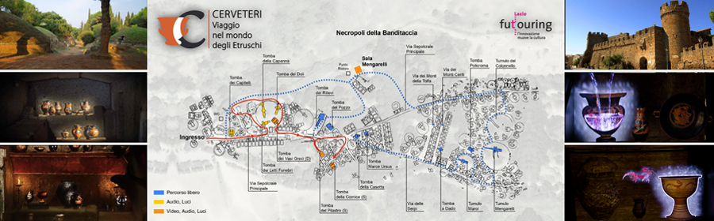
CULTURAL HERITAGE. An engine for innovation and growth – S3 Platform peer review
(Rome, 25th November 2016)
Some products of the DTC1
DTC1 – Third call for projects «Design and rollout of integrated actions to enhance and optimise the use of cultural resources present in the Lazio region through the use of new technologies»
Lot 1: “Cerveteri and the Etruscans”, Etruscan Itineraries: Etruscan monumental necropolises – the Banditaccia necropolis

Slide 12
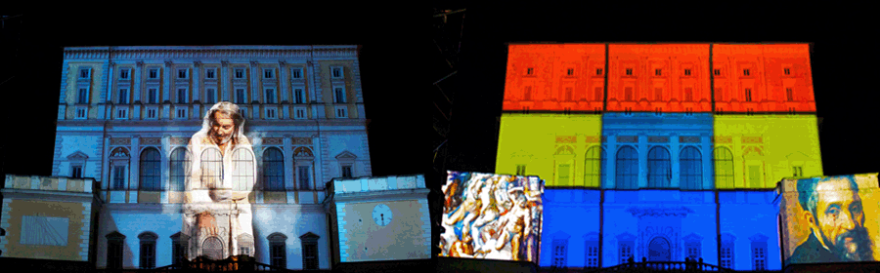
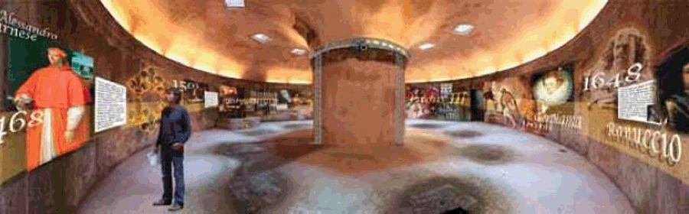
CULTURAL HERITAGE. An engine for innovation and growth – S3 Platform peer review
(Rome, 25th November 2016)
Some products of the DTC1
DTC1 – Third call for projects «Design and rollout of integrated actions to enhance and optimise the use of cultural resources present in the Lazio region through the use of new technologies»
  Lot 2: “The province of Viterbo and the Farnese family”, Farnese Itineraries: Renaissance splendour and dreams, Palazzo Farnese in Caprarola, the Sacred Forest of Bomarzo, Villa Lante della Rovere in Bagnaia;

Slide 13
CULTURAL HERITAGE. An engine for innovation and growth – S3 Platform peer review
(Rome, 25th November 2016)
Forthcoming actions
The new Cultural Heritage Technological District – DTC2 (2016-2020)
Creation of a new Technological District for Cultural assets and activities, through a “Framework Programme Agreement” between the Lazio Region, Ministry for Economic development, Ministry for Education, University and Research and Ministry for Cultural assets and activities and Tourism, with available funding of 41.7 M€ for the performance of actions to make the most of the Lazio region’s cultural resources and to consolidate and stimulate innovation among business enterprises and research bodies dedicated to cultural heritage in the region.
  Extension of the boundaries of the cultural and creative production system, influencing production in other sectors: synergies between culture, tourism and production policies.

Slide 14
CULTURAL HERITAGE. An engine for innovation and growth – S3 Platform peer review
(Rome, 25th November 2016)
Objectives of DTC2
The new Cultural Heritage Technological District – DTC2 (2016-2020)
To grow cohesion among actors forming part of the Technological District and raise competitiveness, with the involvement in single initiatives of Universities and other Research Bodies in Lazio, increasing synergies and collaboration among innovation-rich enterprises in the sector of cultural assets and activities and raising the interest of other enterprises for new services and platforms to promote and develop cultural resources
To encourage the development of demand oriented towards innovative solutions
To increase the supply of cultural tourism, identifying and trying out innovative applications and tools to use and enhance Lazio’s cultural assets, moving towards forms of virtual and multimedia usage;
To create a multipurpose centre for research into and development of new technologies and methods capable of enhancing the sectors in which the district operates

Slide 15
CULTURAL HERITAGE. An engine for innovation and growth – S3 Platform peer review
(Rome, 25th November 2016)
DTC2 Actions
The new Cultural Heritage Technological District – DTC2 (2016-2020)
A new advanced cultural district consisting of:
A new Centre of Excellence, made up of a Skills Register and a Higher Education School, making it possible to identify and develop ad hoc standard and/or masters courses for the definition of new professions in the sphere of Cultural Heritage technologies and to develop research projects through a number of ad hoc laboratories
Research projects for the promotion, preservation, recovery and utilisation of Lazio’s cultural assets, including works not on display («impossible museum»), through the use of digital platforms and other technologies such as the Virtual Heritage Center and Infomediary for technology transfers.
The main innovative technologies to be created and developed must then be applied to 5-6 sites-itineraries chosen by the Lazio Region.

Slide 16
CULTURAL HERITAGE. An engine for innovation and growth – S3 Platform peer review
(Rome, 25th November 2016)
DTC2 Actions
The new Cultural Heritage Technological District – DTC2 (2016-2020)
These main innovative technologies are:
Innovative technologies for Cultural Tourism,
Web-Gis Mobility Systems,
Design and creation of integrated systems for access to and improved use of Cultural Assets,
Technological solutions for security and monitoring,
Research and development of new models, technologies and tools to improve man-machine interaction,
Technological infrastructures for the sustainability of cultural sites (partly through renewable energy sources),
Knowledge acquisition techniques and actions.
Capital investments in start-ups, spin-offs and SMEs wishing to perform technological and innovative activities or needing to modernise or improve process and/or product technologies, to be undertaken in concert with private investors.

Slide 17
CULTURAL HERITAGE. An engine for innovation and growth – S3 Platform peer review
(Rome, 25th November 2016)
DTC2 Actions
The new Cultural Heritage Technological District – DTC2 (2016-2020)
Actions in the sphere of research and development of new technologies and methods to optimise the use of live entertainment (music, theatre, dance).
Activities to support the national and international dissemination and promotion of new technologies and enhanced cultural assets through international distribution agreements, the organisation of incoming missions of overseas tour operators, joint participation of Lazio enterprises in international events.

Slide 18
CULTURAL HERITAGE. An engine for innovation and growth – S3 Platform peer review
(Rome, 25th November 2016)
Forthcomng actions
HELENI PORFYRIOU
Head of the Rome Unit of the Institute for Conservation and Enhancement of Cultural heritage- CNR-ICVBC

Slide 19
CULTURAL HERITAGE. An engine for innovation and growth – S3 Platform peer review
(Rome, 25th November 2016)
Forthcoming actions
Smart Regions as a knowledge- and management-based system.
Metropolitan cities and small historical towns
A new approach that sees the Region as a network for organising knowledge and the management of metropolitan cities and small historic towns in a sustainable manner, in order to prevent/deal with natural disasters and reconstruction work (post-earthquake).
The approach is developed in the following three areas:
  accessibility-safety;
  knowledge-promotion and development;
  training-participation.

Slide 20
CULTURAL HERITAGE. An engine for innovation and growth – S3 Platform peer review
(Rome, 25th November 2016)
Forthcoming actions
Smart Regions as a knowledge- and management-based system.
Metropolitan cities and small historic towns
Management: finance and management methods
Access to territorial data, Assets, places
to improve safety
Knowledge
of Assets and places
for sustainable
promotion and development
Participatory Training
competent participation

Slide 21
CULTURAL HERITAGE. An engine for innovation and growth – S3 Platform peer review
(Rome, 25th November 2016)
Forthcoming actions
Smart Regions as a knowledge- and management-based system.
Metropolitan cities and small historic towns
New digital technologies for knowledge and integrated management of the territory (promotion of a network-based approach to knowledge, participation, monitoring and management).
The first step is to construct a platform that combines geo-referenced data on the land, territory and relative resources with socioeconomic data on cities and small towns as well as historical, artistic and cultural data.
This theme is evidently a very topical one, as seen by:
on the one hand, the recent parliamentary bill, currently going through the lower house (the draft bill allocates 100 million euros to boost the economies of towns having fewer than 5,000 inhabitants and prevent them from emptying), to support the economy of small municipalities that are continuing to dwindle in size;
on the other, recurring natural disasters (such as the Amatrice earthquake and subsequent seismic events) and resulting socioeconomic fragility and crisis of identity, requiring farsighted policies.

Slide 22
CULTURAL HERITAGE. An engine for innovation and growth – S3 Platform peer review
(Rome, 25th November 2016)
Open issues
Business models:
Innovation:
Interregional and international
cooperation :
How to encourage more effective models of public-private cooperation?
What role can public sector demand play, with tools such as Pre-Commercial-Procurement?
How can new technologies help to raise the use made of cultural resources?
How can contamination between the humanities and digital sciences serve as a basis for broadening the range of products and services in the sphere of cultural heritage promotion and development?
How to promote interregional cooperation in Europe among S3 specialisation areas in order to facilitate the sharing of experiences and increase cooperation in the areas of research, innovation and commerce?

Slide 23
CULTURAL HERITAGE. An engine for innovation and growth – S3 Platform peer review
(Rome, 25th November 2016)
Questioni aperte
Modelli di business:
Innovazione:
Cooperazione
interregionale e internazionale:
Come favorire più efficaci modelli di collaborazione pubblico-privato?
Quale ruolo può avere la domanda pubblica con strumenti quali il
Pre-Commercial-Procurement?
Come possono le nuove tecnologie allargare la possibilità di fruizione dei beni culturali?
Come la contaminazione tra le scienze umanistiche e quelle digitali può costituire la base per un allargamento dell’offerta di prodotti e servizi nell’ambito della valorizzazione dei beni culturali?
Come promuovere la cooperazione europea interregionale tra le aree di specializzazione della S3 per facilitare gli scambi delle esperienze, per raggiungere una maggiore cooperazione in termini di ricerca, innovazione e controparti commerciali?

