Slide 1
Innovation for Cultural Heritage
Arthur Le Gall – KEA European Affairs
@Arthur_LeGall
KEA Video
Roma, 25 November 2016

Slide 2
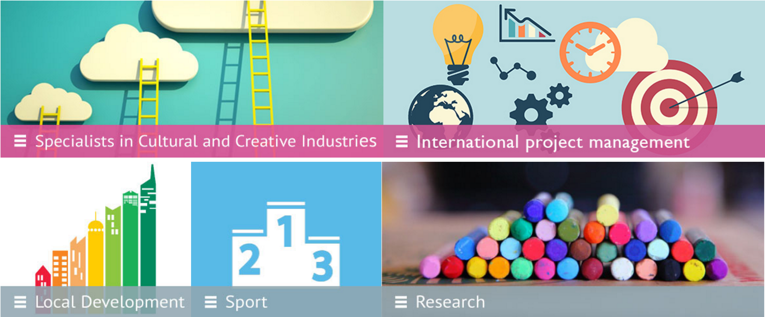
Who we are
KEA European Affairs is a research and advisory company based in Brussels and Shenzhen (China) specialising in providing advice, support and research in relation to cultural and creative sectors and sport since 1999.
WHAT WE DO
Cultural development strategy (advice for regions, cities, States)
Studies and research in the cultural and creative sectors
Advice in EU law: copyright, competition
Training and capacity building
EU project management and access to funding (CREATIVE EUROPE, H2020, COSME, INTERREG, …)
Notes:
Our services include research and analysis, public affairs strategy, public relations, fund raising, network management and event management

Slide 3
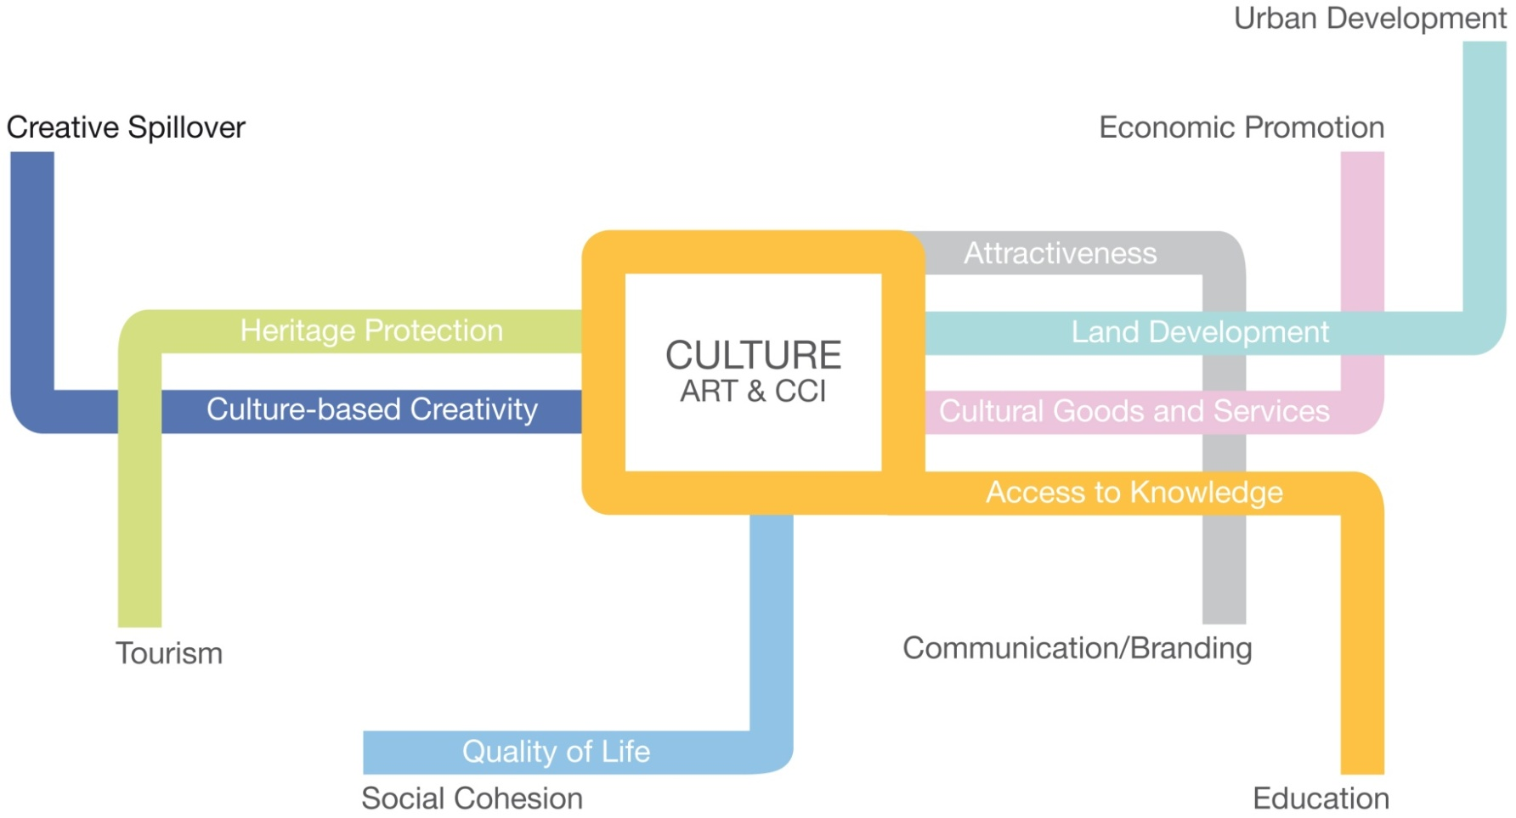
Cultural Heritage and territorial development
Cultural Heritage
CCIs
Notes:
Slide to show broad impact of CH & CCIs

Slide 4
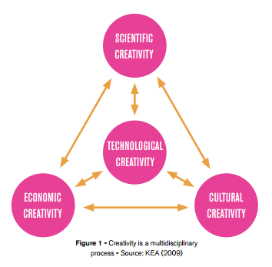
What is innovation for Cultural Heritage?
Notes:
Innovation stem from different skills, different forms of creativity.
Many different enablers and drivers – important from a Policy perspective to have a broad understanding and to be open to those manifold shapes & shades of innovation.
Innovation = something new? Or new ways to use what exists.

Slide 5
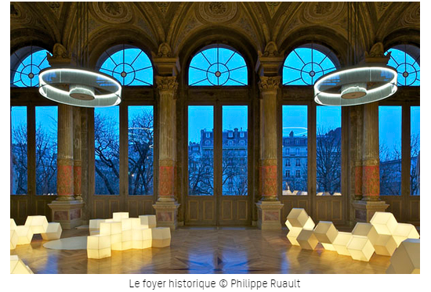
What is innovation for Cultural Heritage?
Innovation in spaces
Vibrancy of our territories
Impact on urban regeneration
Transitional uses and re-purposing of heritage sites
Multimodal spaces, creative hubs, co-working spaces.
Notes:
Barcelona Art Factories, ‘old industrial spaces, new
cultural uses’
Programme initiated in 2007.
Has transformed nine obsolete industrial sites into public
venues that drive culture and innovation.
30,000 square meters for artistic and cultural creation and
production.
The factories are conceived as powerhouses for local development. Place for experimentation, creation, innovation, training and open discussion.
Goes beyond traditional paradigms of access to culture by building bridges with other professional networks (educational, social, business, academic) that allow for cross-sectorial initiatives.

Slide 6
Innovation in user experiences
ARoS is developing a whole floor of digital experiences to reach out to new audiences and break the idea of an elitist culture.
Moesgaard Museum: has a multi-skilled team that works as an in-house laboratory and enable them to design, test and fast-prototype new experiences for its audiences.
Understanding of users and audiences’ needs and desires.
Notes:
Aarhus (Denmark), ‘City of Museums’
Medium-size city of around 330.000 inhabitants.
Entrenched cultural sector: tax incentives, private sponsorship.
The museum sector is a key political focus. Over the past 12 years, heavy investments have been made in building and refurbishing museums. This has given Aarhus a leading position as a tourist destination in Denmark.
Key cultural infrastructure: Den Gamle By (open-air museum), ARoS (modern art museum), Moesgaard Museum (prehistory and ethnography).
The city will be ECoC in 2017.
Theme ‘Let’s Rethink’: aims to create a ‘cultural laboratory’ in the region (new practices, new ways of forming partnerships, new business models and new concepts of growth). Focus on urban development, integration, business development, tourism, infrastructure and international collaborations.

Slide 7
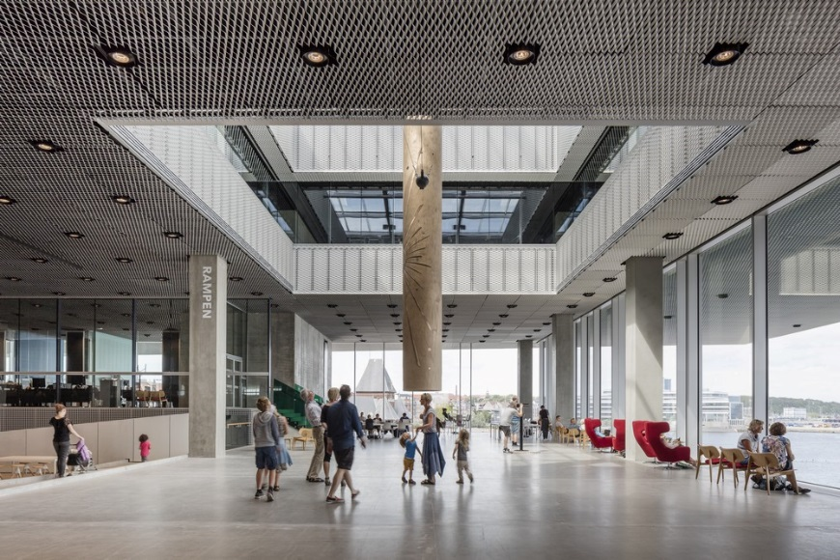
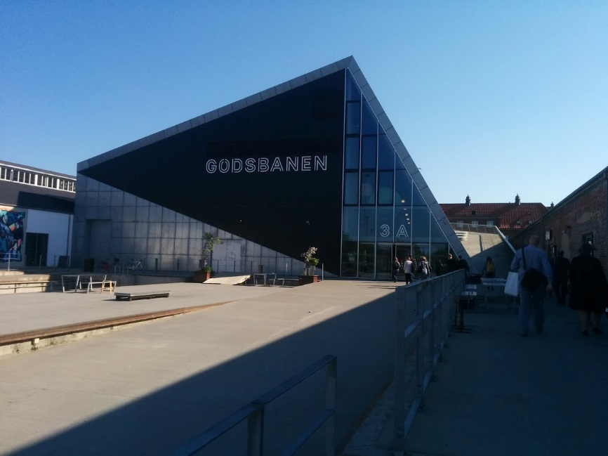
What is innovation for Cultural Heritage?
Innovation in user experiences
CH infrastructures and activities are anchored in the socio-economic context of the city and fill an identified gap.
knowledge of users and audiences’ needs and desires.
Flexibility to adapt to changes, making room for appealing new projects.

Slide 8
What is innovation for Cultural Heritage?
Frugal and participatory innovation
Porto’s Bank of Materials, Portugal
Porto is one of the oldest European city centres, proclaimed a UNESCO World Heritage site in 1996 and ECoC in 2001.
Preserve heritage and turn a social problem (theft and degradation) into a cultural opportunity
Notes:
Porto is a city covered in tiles. Buildings are covered with ceramic materials, decorated with iron balconies, door frames and handles, and adorned with detailed drawings.
The Bank of Materials is a museum open to the public since 2010. Prior to that, it was a reserve for saving Porto’s typical building materials from destruction, collecting and cataloguing them for research and giving them back free of charge to citizens for construction and building conservation, thereby safeguarding the city’s architectural heritage.
Since the bank’s opening as a museum in 2010, 15,000 pieces have been collected. At
least 100 buildings were rehabilitated and more than 1,400 benefited from technical support from the Bank of Materials. The museum has welcomed more than 21,000 visitors since 2010: it organises guided visits and workshops for citizens to learn about the techniques and evolution of materials used in the local built heritage.
The Bank of Materials managed to turn a social problem (theft and degradation) into a cultural opportunity.

Slide 9
What is innovation for Cultural Heritage?
Innovating with Citizens
Merida – citizen-driven preservation of heritage
Notes:
Mérida (Spain)
The “Archaeological Ensemble” of Mérida (Spain) was listed as a UNESCO World Heritage site in 1993.
Strong relationship between the heritage protection and urban development: the city’s Special Protection Plan aims to make the urban development distribution compatible with heritage protection.
The Consortium of the Monumental City of Mérida created in 1996 to coordinate the many activities involved in managing the town’s heritage. The Consortium implemented the Special Protection Plan.
The Consortium has been acclaimed by UNESCO, which rewarded Mérida with a “Good Practice” label in the category “Good Management Model of Historic Heritage”. It was also awarded the First Prize for Cities of World Heritage in 2008.
The “Mecenas” initiative is open to citizens, associations, institutions and companies, which can become patrons of heritage sites and receive advantages in return (free entrance, shop discounts, special events invitations, etc.).
“The School adopts a monument” initiative allows for the participation of schools in heritage protection and knowledge dissemination. Schools sponsor a monument and develop activities around it during the year, with privileged access to the site.
The “Heritage Emeritus” initiative is a programme of social volunteering, with the ultimate aim of promoting and facilitating access to heritage, especially to those groups that are at risk of poverty or social exclusion (unemployed, sick, from disadvantaged areas, etc.). Through these programmes, citizens can discover heritage and become involved in visits. Cultural volunteers support consortium staff, and help raise awareness about heritage sites.

Slide 10
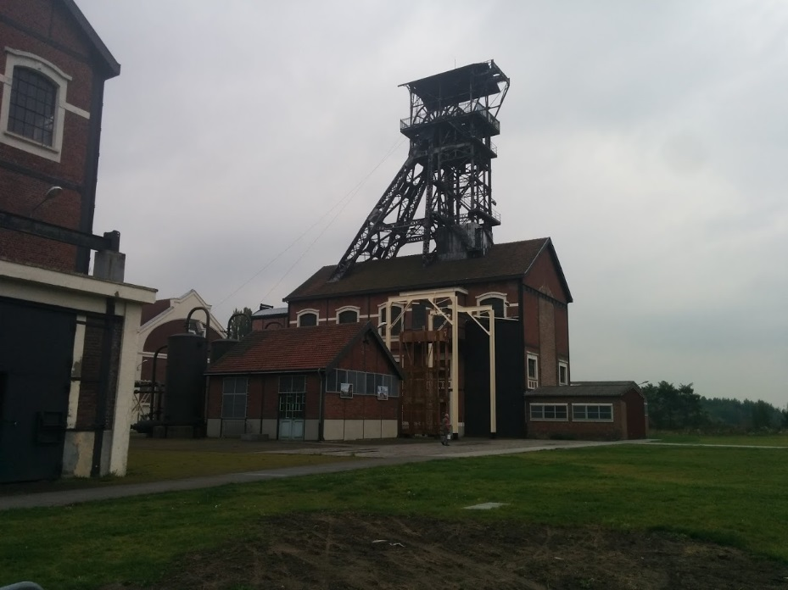
What is innovation for Cultural Heritage?
Social innovation & Ownership
Louvres-Lens: a massive investment in cultural heritage
Empowering citizens in a mining region: emergence of bottom-up projects
Notes:
Nord-Pas de Calais (France)
The Nord-Pas de Calais region has been investing quite massively in culture over the past few years (€52 million in 2014 - 3rd region in France), despite the fact that it is below national average in terms of employment and GDP per capita.
Deep crisis triggered by the decline of the mining activity. Culture is seen as an alternative driver of regional development.
Euralens
Born in 2009 with the arrival of the Louvre in Lens, Euralens is a governance tool that aims to accelerate urban, economic, social and cultural transformation.
Euralens is primarily defined as a forum for stakeholders of all backgrounds from the Pas de Calais mining area. The Euralens method is to create an exchange between actors, project planning authorities and external high-level expertise. This governance model becomes a key variable to ensure sustainability.
Euralens also acts as a project incubator, because the “Euralens label” endorses sustainable and innovative initiatives in terms of economy, urban planning and culture.
Spillovers: the regeneration of the area is stemming from cultural investment yet this initial impulse sustains broader social and economic dynamics: a lot of projects labelled through Euralens have a stronger focus on economic development, infrastructures, housing and the green economy.

Slide 11
How to make it happen?
Management/governance level
  The importance of political will & awareness: acknowledging the different forms of cultural heritage impacts to stir innovation
  open/participatory approaches: Public institutions as mediators and facilitators to combine bottom-up and top-down approaches for sustainable policies
  Flexible policy-making and tools
  Cross-fertilisation of skills
  Creative, technical and professional skills and competences from different sectors should be integrated to bring about spill-over effects.
  Already happening ! New materials and new ideas for the restoration of buildings/management of CH sites
  Mutual understanding and trust
Notes:
The example of Mérida and Helsinki-Espoo.
Policies must be constantly assessed and subsequently improved.
Kulps! (Espoo): an umbrella programme facilitating the development of outside activities for children (partnerships between schools and cultural organisations).
Kultus platform (Helsinki): digital platform
supporting matchmaking between cultural offer for
kids and schools.
Creative, technical and professional skills and competences from different sectors should be integrated to bring about spill-over effects.
For that to happen, capacity-building and awareness-raising activities can be organised: public events, competitions and calls for projects, co-working spaces, clusters, incubators, etc.
New materials and new ideas for the restoration of buildings and use of spaces can be developed.
Holistic approach: heritage doesn’t only have an impact on the cultural sphere, but also on the economic, educational and societal arenas.
The ultimate goal is for this process to lead to a creative sector for sustainable architecture and heritage.
The example of Barcelona Art Factories and Nord-Pas de Calais.
Creative, technical and professional skills and competences from different sectors should be integrated to bring about spill-over effects.
For that to happen, capacity-building and awareness-raising activities can be organised: public events, competitions and calls for projects, co-working spaces, clusters, incubators, etc.
New materials and new ideas for the restoration of buildings and use of spaces can be developed.
Holistic approach: heritage doesn’t only have an impact on the cultural sphere, but also on the economic, educational and societal arenas.
The ultimate goal is for this process to lead to a creative sector for sustainable architecture and heritage.
The example of Barcelona Art Factories and Nord-Pas de Calais.

Slide 12
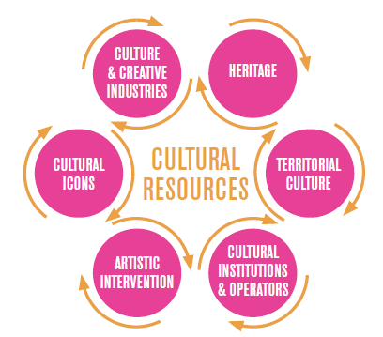
How to make it happen?
Play to your strengths
Notes:
Link with the local environment
Key actors (public institutions, cultural organisations, etc.) should identify their strengths, weaknesses and needs ex ante.
This prior research will draw a state of play upon which specific cultural initiatives and policy actions can develop.
Every city/region is a unique creative
space with its own history and identity
(economic, social, cultural); hence the
importance of tailored programmes.
The idea is to create a vibrant local ecosystem.
Cooperation among stakeholders is vital.
The examples of Nord-Pas de Calais (Euralens) and Porto.

Slide 13
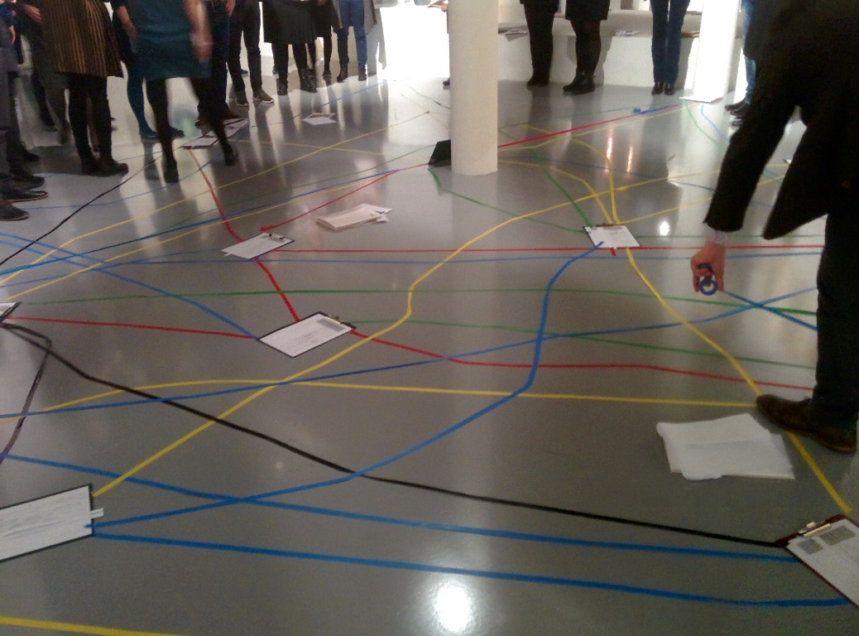
Conclusions/discussion points
Go broad !
Partnerships & Trust
Rethink
Ownership & Bottom-up initiatives
What is tomorrow’s heritage?
Notes:
There should be no fear to question the unquestionable and to welcome new paradigms.

Slide 14
Thanks!
Arthur Le Gall
alegall@keanet.eu
51 Rue du Trône
B-1050 Brussels
 +32 2 289 26 00
www.keanet.eu
Social Media:
Creative Europe on Linkedin/Facebook
@KEAtweets

