Slide 1
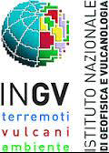

The role of Copernicus for post-seismic analysis and integration with in situ data
Salvatore Stramondo
Satellite Earth Observation unit
National Earthquake Center
Istituto Nazionale di Geofisica e Vulcanologia
SMART SPECIALISATION AND CULTURAL HERITAGE:
AN ENGINE FOR INNOVATION AND GROWTH
Rome, November 25th, 2016

Slide 2
Copernicus is a European system for monitoring the Earth.
Copernicus consists of a complex set of systems which collect data from multiple sources: earth observation satellites and in situ sensors such as ground stations, airborne and sea-borne sensors.
Copernicus processes these data and provides users with reliable and up-to-date information.
The services address six thematic areas: land, marine, atmosphere, climate change, emergency management and security.
The main users of Copernicus services are policymakers and public authorities who need the information to take critical decisions in the event of an emergency, such as a natural disaster or a humanitarian crisis.
SMART SPECIALISATION AND CULTURAL HERITAGE:
AN ENGINE FOR INNOVATION AND GROWTH
Rome, November 25th, 2016

Slide 3
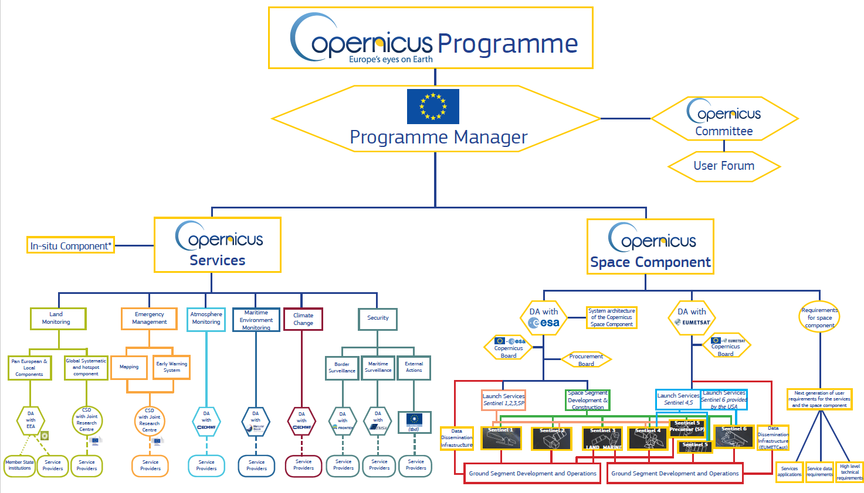
SMART SPECIALISATION AND CULTURAL HERITAGE:
AN ENGINE FOR INNOVATION AND GROWTH
Rome, November 25th, 2016

Slide 4
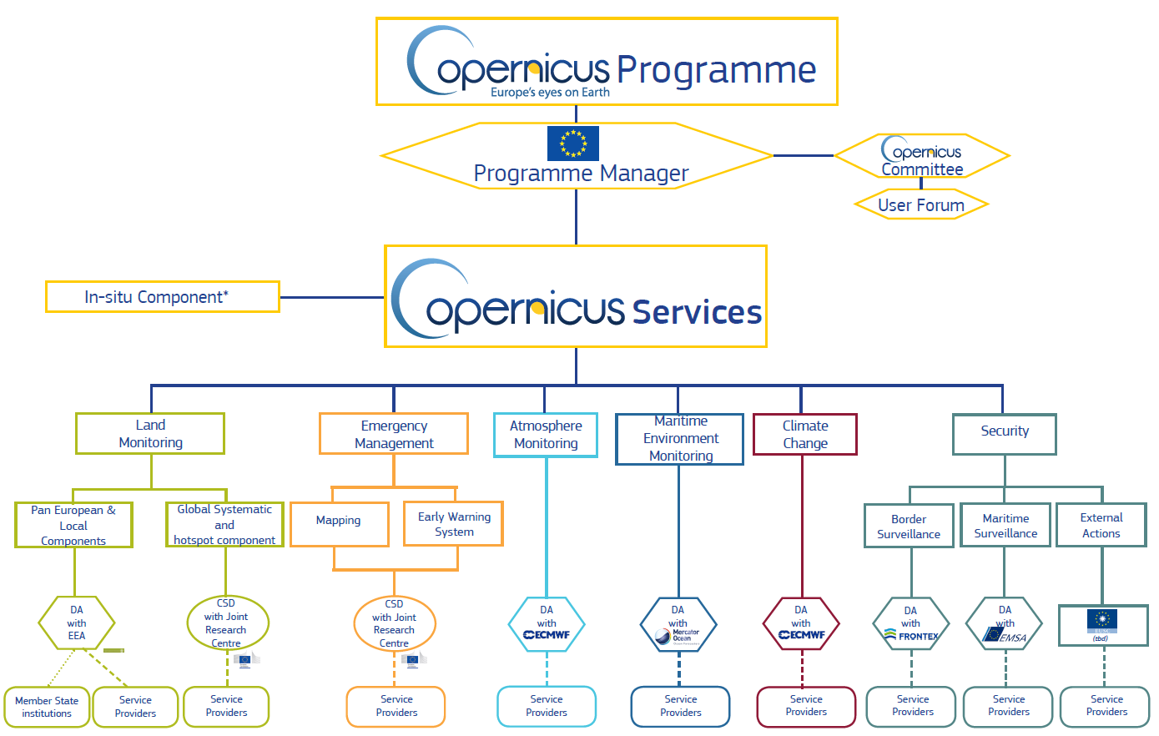
SMART SPECIALISATION AND CULTURAL HERITAGE:
AN ENGINE FOR INNOVATION AND GROWTH
Rome, November 25th, 2016

Slide 5
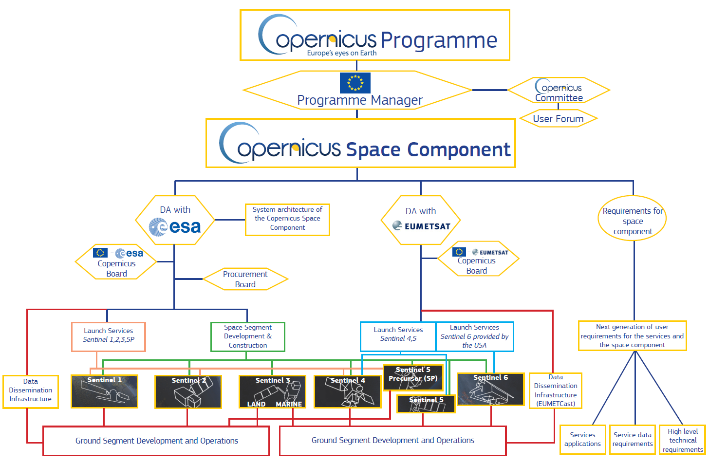
SMART SPECIALISATION AND CULTURAL HERITAGE:
AN ENGINE FOR INNOVATION AND GROWTH
Rome, November 25th, 2016

Slide 6
An FP7 Project: APhoRISM – Advanced Procedures for volcanIc and Seismic Monitoring
Aims at:
- developing innovative Copernicus products derived from the integrated use of Space- and Ground-based data to support the management and mitigation of seismic and volcanic risk
- providing new tools for managing seismic and volcanic crisis
- exploiting available and upcoming (e.g. Sentinel missions) instruments for achieving better performances in terms of accuracy and quality.
SMART SPECIALISATION AND CULTURAL HERITAGE:
AN ENGINE FOR INNOVATION AND GROWTH
Rome, November 25th, 2016

Slide 7
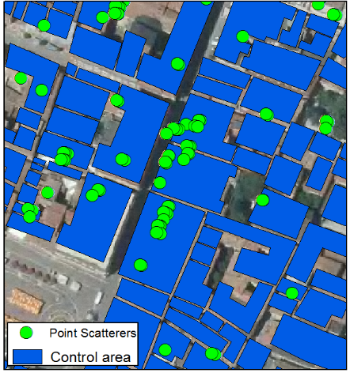
An FP7 Project: APhoRISM – Advanced Procedures for volcanIc and Seismic Monitoring
I_{T} = soil natural oscillation period index (seismic amplification)
I_{A} = soil amplification.
I_{V} = InSAR velocity index (subsidence/slow landslides)
I_{L} = liquefaction instability index (liquefaction phenomena)
I_{S} = landslide instability index (landslide hazard)
Soil instability | I_{F}
null | 0
low | 0-1
moderate | 1-2
High | >2
SMART SPECIALISATION AND CULTURAL HERITAGE:
AN ENGINE FOR INNOVATION AND GROWTH
Rome, November 25th, 2016

Slide 8
An application to damaged historical centers
Damage classification by using all change fea-tures (both optical and SAR) over Amatrice town
Damage classification in the historical centre
Ground survey: Amatrice post- earthquake
SMART SPECIALISATION AND CULTURAL HERITAGE:
AN ENGINE FOR INNOVATION AND GROWTH
Rome, November 25th, 2016

Slide 9
Multisource/Multiscale survey of historical buildings and critical infrastructures in a seismic urban environment
Satellite and in situ data can be integrated in order to perform complementary analysis:
- Ground-based RAR measurements are performed to
estimate the vibration displacements and the natural
oscillation frequencies of structures.
Ground-based SAR can monitor surface displacements
Satellite-based SAR can investigate surface deformation phenomena, and hence, point out potential risks within an urban environment
SMART SPECIALISATION AND CULTURAL HERITAGE:
AN ENGINE FOR INNOVATION AND GROWTH
Rome, November 25th, 2016

Slide 10
Multisource/Multiscale survey of historical buildings and critical infrastructures in a seismic urban environment
Long-term and regional-scale survey by Copernicus Sentinel data
Short-term and local-scale survey of the area strictly closed to the historical compound
Near-real-time and building-scale survey of historical compound by GBRAR
SMART SPECIALISATION AND CULTURAL HERITAGE:
AN ENGINE FOR INNOVATION AND GROWTH
Rome, November 25th, 2016

Slide 11
Hints for discussion
Copernicus services are addressed to stakeholders and decision makers. What is the level of knowledge of targeted users?
Copernicus data and in-situ data today are integrated in order to provide more useful and reliable information. Is such multisource approach effective for post-seismic investigation within historical centers?
Copernicus novel missions (i.e. today Sentinel 1-2) make available an unprecedented set of data, either in terms of temporal sampling or for their global coverage. The user community should be ready to fully exploit such assets and ingest outcomes in decision chains. Is this the scenario today?
SMART SPECIALISATION AND CULTURAL HERITAGE:
AN ENGINE FOR INNOVATION AND GROWTH
Rome, November 25th, 2016

