Slide 1

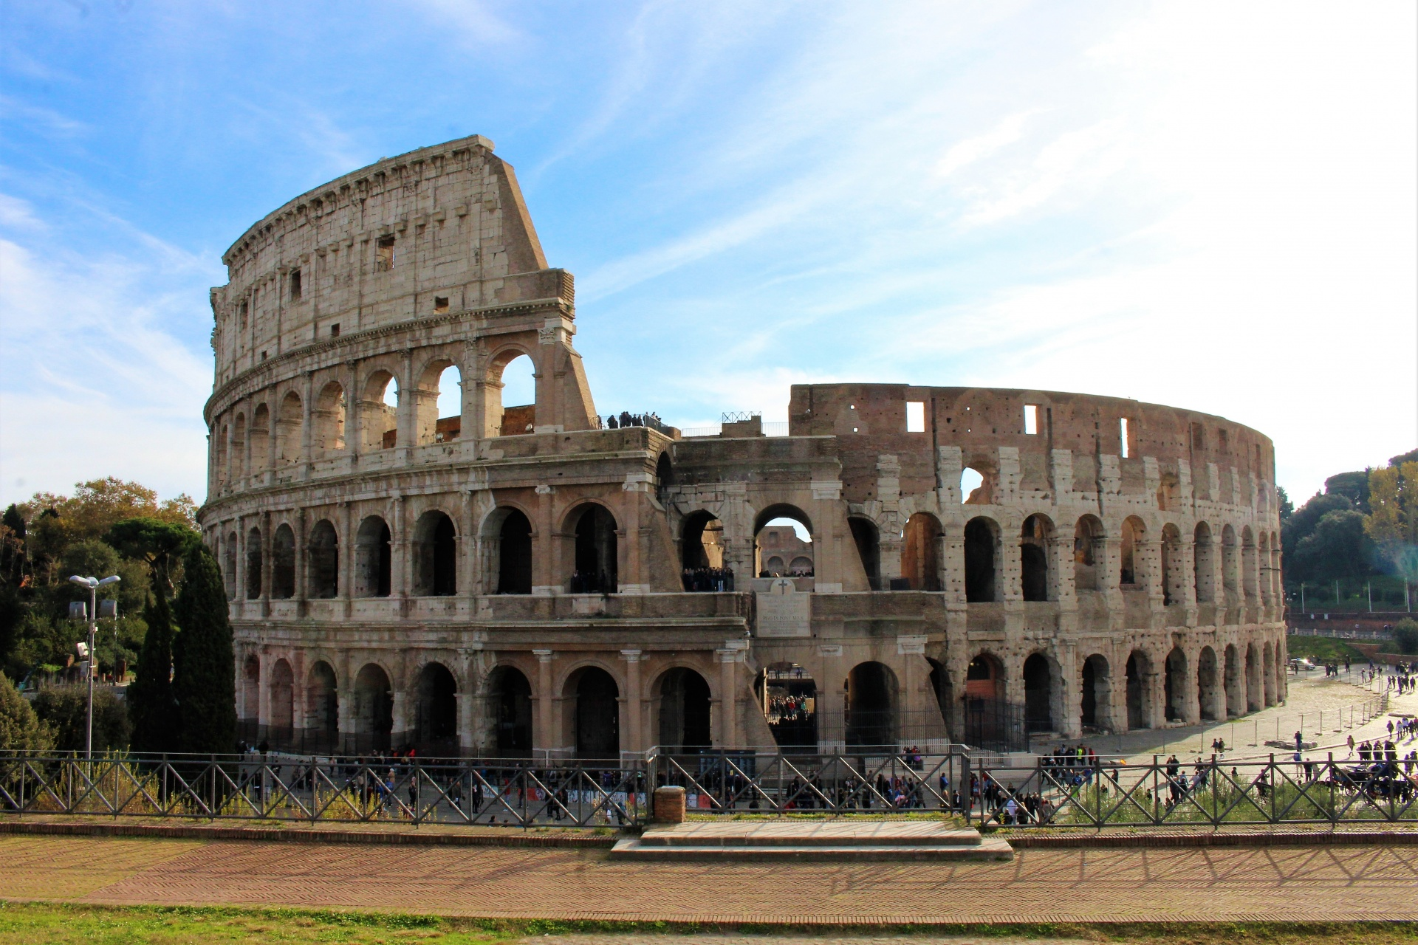


LAZIO
INVEST IN LAZIO
CHOOSE THE REGION OF ROME
A Region of Beauty and Innovation

Slide 2

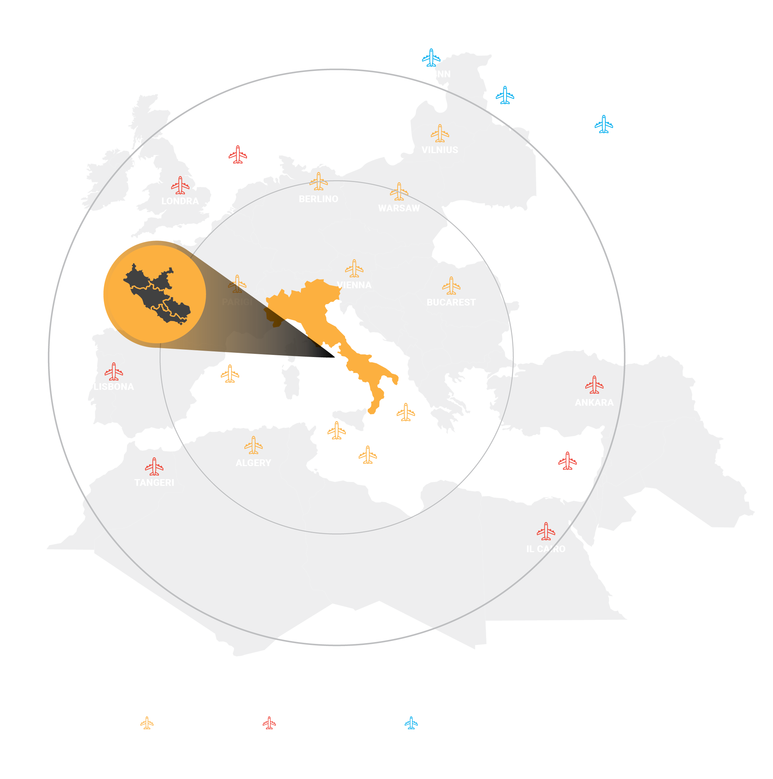
WELCOME TO LAZIO
REGION OF ROME, HEART OF EUROPE
AND CENTRE OF THE MEDITERRANEAN AREA
WHY LAZIO
Lazio boasts a geopolitical position of global importance:
in the heart of Europe and at the center of the Mediterranean region,
a crossroad towards the Middle East and South-East Asia.
  Lazio is the 2nd Italian Region for Gross Domestic Product (GDP) with 239 Bn euros, contributing to 11% of Italian national GDP.
  Lazio is the Italian Region with the highest level of specialization in manufacturing and in high-tech knowledge intensive sectors.
  Lazio’s share of exports in global leading sectors is twice the national average (in percentage terms 72% vs 32%).
Notes:
AGGIUNTO - WHY LAZIO
Aggiornato dati

Slide 3

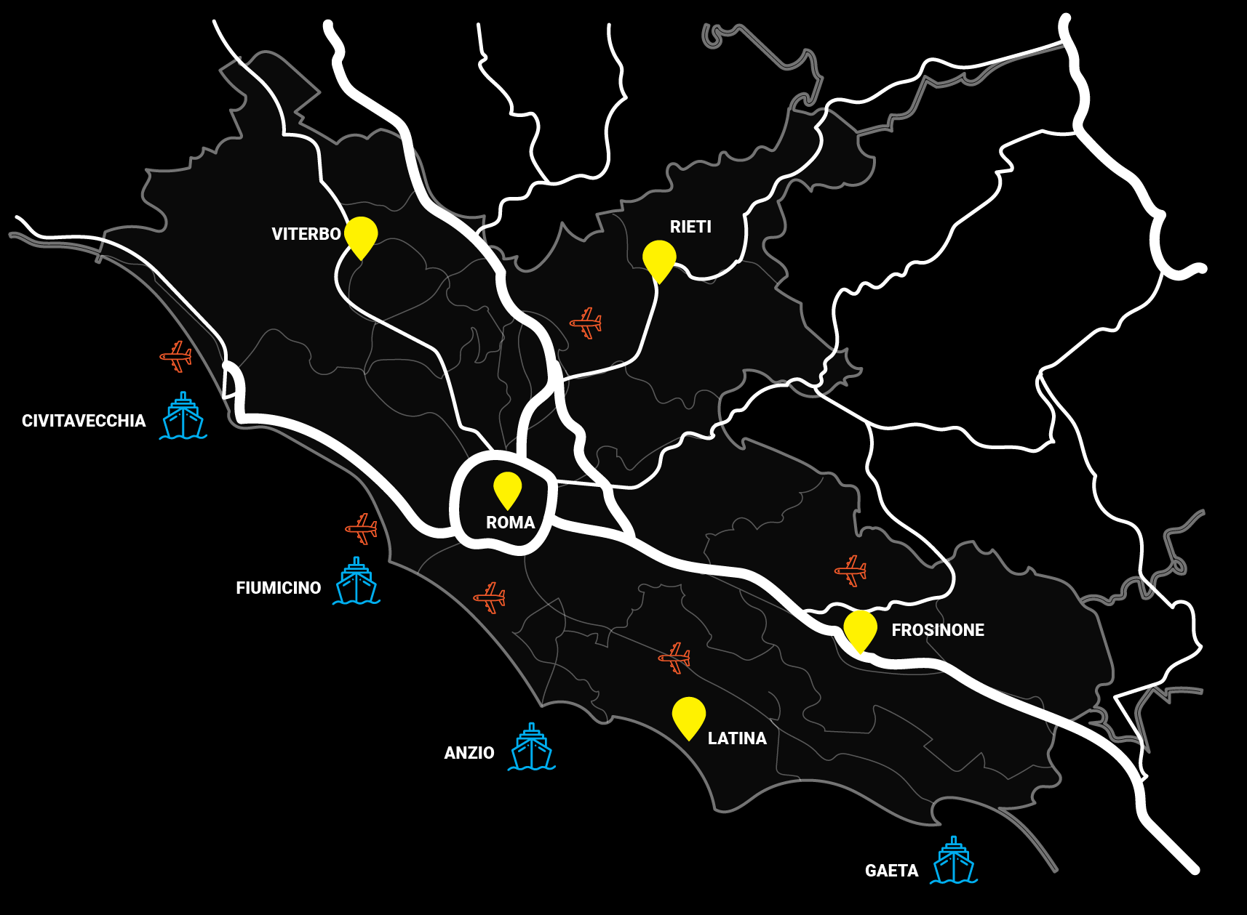




LAZIO,
A CONNECTED REGION
LAZIO REGION IS A STRATEGIC LOGISTICAL PLATFORM IN ITALY AND EUROPE
2 International Airports (Fiumicino and Ciampino, over 50 million passengers per year). Fiumicino Leonardo Da Vinci Airport is the first stopover in Italy and the first European airport in terms of traveler satisfaction.
Civitavecchia Port is the major Italian cruise port, the 2nd in Europe and 7th in the world for number of passengers (3 million per year). It boasts the handling 10 million tons of goods a year.
2 main railway stations (Termini and Tiburtina) which guarantee high speed rail connections with all major Italian and European cities. Lazio is part of the Trans-European Networks - Transport (TEN-T).
Main Highways: A1 Milano-Roma-Napoli, A12 Roma-Civitavecchia, A24 Roma-L’Aquila. The extension of the road network in Lazio Region consists of approximately 10 thousand kilometers, of which 473 are motorways and 553 national roads.
Notes:
-SOSTITUIRE CARTINA LAZIO CON CARTINA EUROPEA.
- Aggiungere fusi orari e distanza con le principali capitali europee (direttamente sulla cartina).
FUSI ORARIO -Differenza di fuso orario tra Roma, Italia e altre città (dateandtime.info)
DISTANZE VOLO TRA ROMA E PRINCIPALI CITTA’ - Calcolatore della durata di volo | Tempo di Volo (tempo-di-volo.it)

Slide 4






ALL ROADS LEAD TO ROME
THE STRATEGIC ROLE OF ROME FOR THE ATTRACTIVENESS OF THE LAZIO REGION
DIPLOMACY
TOURISM
Rome hosts 209 diplomatic missions (embassies, consulates, permanent missions and other diplomatic representations) according to Global Diplomacy Index 2019.
Rome, with over 20 million tourists a year, is the most visited city in Italy and one of the most visited in the world.
ROME AS A STRATEGIC HUB
2 International airports: Fiumicino and Ciampino. Fiumicino Airport is connected to Rome by the direct train "Leonardo Express". Travelling time: only 32 minutes, trains run every 15 min.
VATICAN STATE
Rome is home to the Vatican State, with its own 85 diplomatic representations of the main countries,
residence of the Pope and home to the Basilica of
St. Peter, the Vatican Museums and the Sistine Chapel.
3 major railway stations: Termini, Tiburtina and Ostiense.
Head office of the important logistics center: CAR - the ROME AGRI-FOOD CENTRE (agroalimroma.it).
Notes:
ok fs

Slide 5






LAZIO,
REGION OF CULTURE
Lazio hosts most important monuments and UNESCO sites.
Rome and the Vatican City are among the ten most famous destinations in the world, with a unique artistic and cultural heritage.
LAZIO HOSTs MOST IMPORTANT MONUMENTs: Flavian Amphitheater-Colosseum, Palatine Hill and Palatine Museum, Trajan's Markets and Forum, Baths of Caracalla, Ostia Antica, Villa Adriana AND Villa D’este, Abbazia di Montecassino.
250
53
MUSEUMS AND ART GALLERIES
6
MONUMENTS
UNESCO
SITES
9
35
59
CENTRAL INSITUTES OF THE MINISTRY OF CULTURAL
ARCHEOLOGICAL
AREAS AND PARKS
THEATRES
Notes:
Ok fs
Dati aggiornati

Slide 6



INTERNATIONAL ORGANISATIONS HEADQUARTERS:
WORLD CLASS
HEALTH FACILITIES:
32 HOSPITAL
4 UNIVERSITY POLYCLINICS
8 IRCCS, i.e. HOSPITALS OF EXCELLENCE that pursue research purposes, mainly clinical and translational, in the biomedical field and in the organization and management of health services. Among them, the INMI SPALLANZANI HOSPITAL and the IFO HOSPITAL.
EUROPE AN BRAIN RESEARCH INSTITUTE
IRBM - "PIERO ANGELETTI" MOLECULAR BIOLOGY RESEARCH INSTITUTE
CENTRES OF EXCELLENCE IN THE FIELDS OF ONCOLOGY, NEUROSCIENCE, GENETIC THERAPY AND STEM CELLS
FOOD AND AGRICULTURAL ORGANISATION
INTERNATIONAL FUND FOR AGRICULTURAL
DEVELOPMENT
WORLD FOOD PROGRAMME
INTERNATIONAL GENETIC RESOURCES INSTITUTE
INTERNATIONAL CENTRE FOR THE STUDY OF THE PRESERVATION
AND RESTORATION OF CULTURAL HERITAGE
Notes:
ok fs

Slide 7











LAZIO
FACTS & FIGURES
65,43%
5.707.112
POPULATION
EXPORT CAPACITY
IN SECTORS WITH
DYNAMIC GLOBAL DEMAND
187.000
EMPLOYEES IN HIGH-TECH SECTORS
32,2 BN EURO
152.000
EXPORT
EMPLOYEES OF
INTERNATIONAL COMPANIES
1.783
    34.549 EURO
STARTUPS + INNOVATIVE SMEs
INCOME PER CAPITA
2,0 %
17.242
R&D EXPENDITURE ON REGIONAL GDP
SURFACE AREA
4.149
239 BN EURO
LOCAL UNITS OF FOREIGN ENTREPRISES
GDP
Notes:
MODIFICATO IL TITOLO
INSERISCI DATO RELATIVO AI N. DISOCCUPATI - UNEMPLOYMENT E FORZA LAVORO ATTIVA – LABOUR POOL.
INSERISICI LA FONTE DEI DATI – ISTAT – INSERIRE UNA SLIDE FINALE BIBLIOGRAFIA DATI
Labour Pool: 1.6 Mn
Unemployment: ?? Dato importante per l’AIE (non è un male se la % è alta)
Pro Capita Income: 32.440 Euro

Slide 8




WHY LAZIO
LAZIO, REGION OF CULTURE AND CREATIVITY
FIRST ITALIAN REGION BY SHARE OF ADDED VALUE AND EMPLOYMENT PRODUCED BY THE CULTURAL and CREATIVE PRODUCTION SYSTEM.
LAZIO, REGION OF INNOVATION
one of the most important R&D
and INNOVATION SYSTEMS IN ITALY AND world class international excellences.
Lazio Sectors of excellence FOR INNOVATION, RESEARCH AND human resources:
1. LIFE SCIENCES & BIOTECH
2. AEROSPACE & SECURITY INDUSTRY
3. TOURISM & CulturE TECH
4. AUDIOVISUAL & FILM INDUSTRY
5. ict, CREATIVE AND DIGITAL INDUSTRIES
6. AUTOMOTIVE & sustainable mobility
7. AGRIFOOD
8. BLUE ECONOMY
9. GREEN eCONOMY
LAZIO, REGION OF KNOWLEDGE
TOP-RANKING in EUROPE FOR NUMBER OF RESEARCHERS, UNIVERSITIES AND PUBLIC AND PRIVATE RESEARCH INSTITUTIONS.
Notes:
Ok fs

Slide 9






LAZIO,
REGION OF INNOVATION
Lazio hosts global industrial players from all over the world that run their R&D activities
Lazio hosts many public and private research centres
Tech Districts & Clusters play a role as aggregators, knowledge enablers and in technology transfer.
5
SCIENTIFIC AND
TECHNOLOGICAL PARKS:
ROME TECHNOPOLE
TECNOPOLO TIBURTINO
TECNOPOLO CASTEL ROMANO
PST ALTO LAZIO
PALMER FERENTINO
4
TECHNOLOGICAL
NATIONAL CLUSTERS:
ALISEI – LIFE SCIENCES
CTNA – AEROSPACE
BIG – BLUE ECONOMY
SPRING - BIOECONOMY
3
TECHNOLOGICA DISTRICTS:
DTB – LIFE SCIENCES
DTA – AEISPACE
DTC – CULTURE TECH
1.783
STARTUPS + INNOVATIVE SMEs
7
€ 3.9 BN
60.683
21
CERTIFIED BUSINESS INCUBATORS
R&D EXPENDITURE
TOTAL EMPLOYED
IN R&D
NATIONAL RESEARCH CENTRES

Slide 10
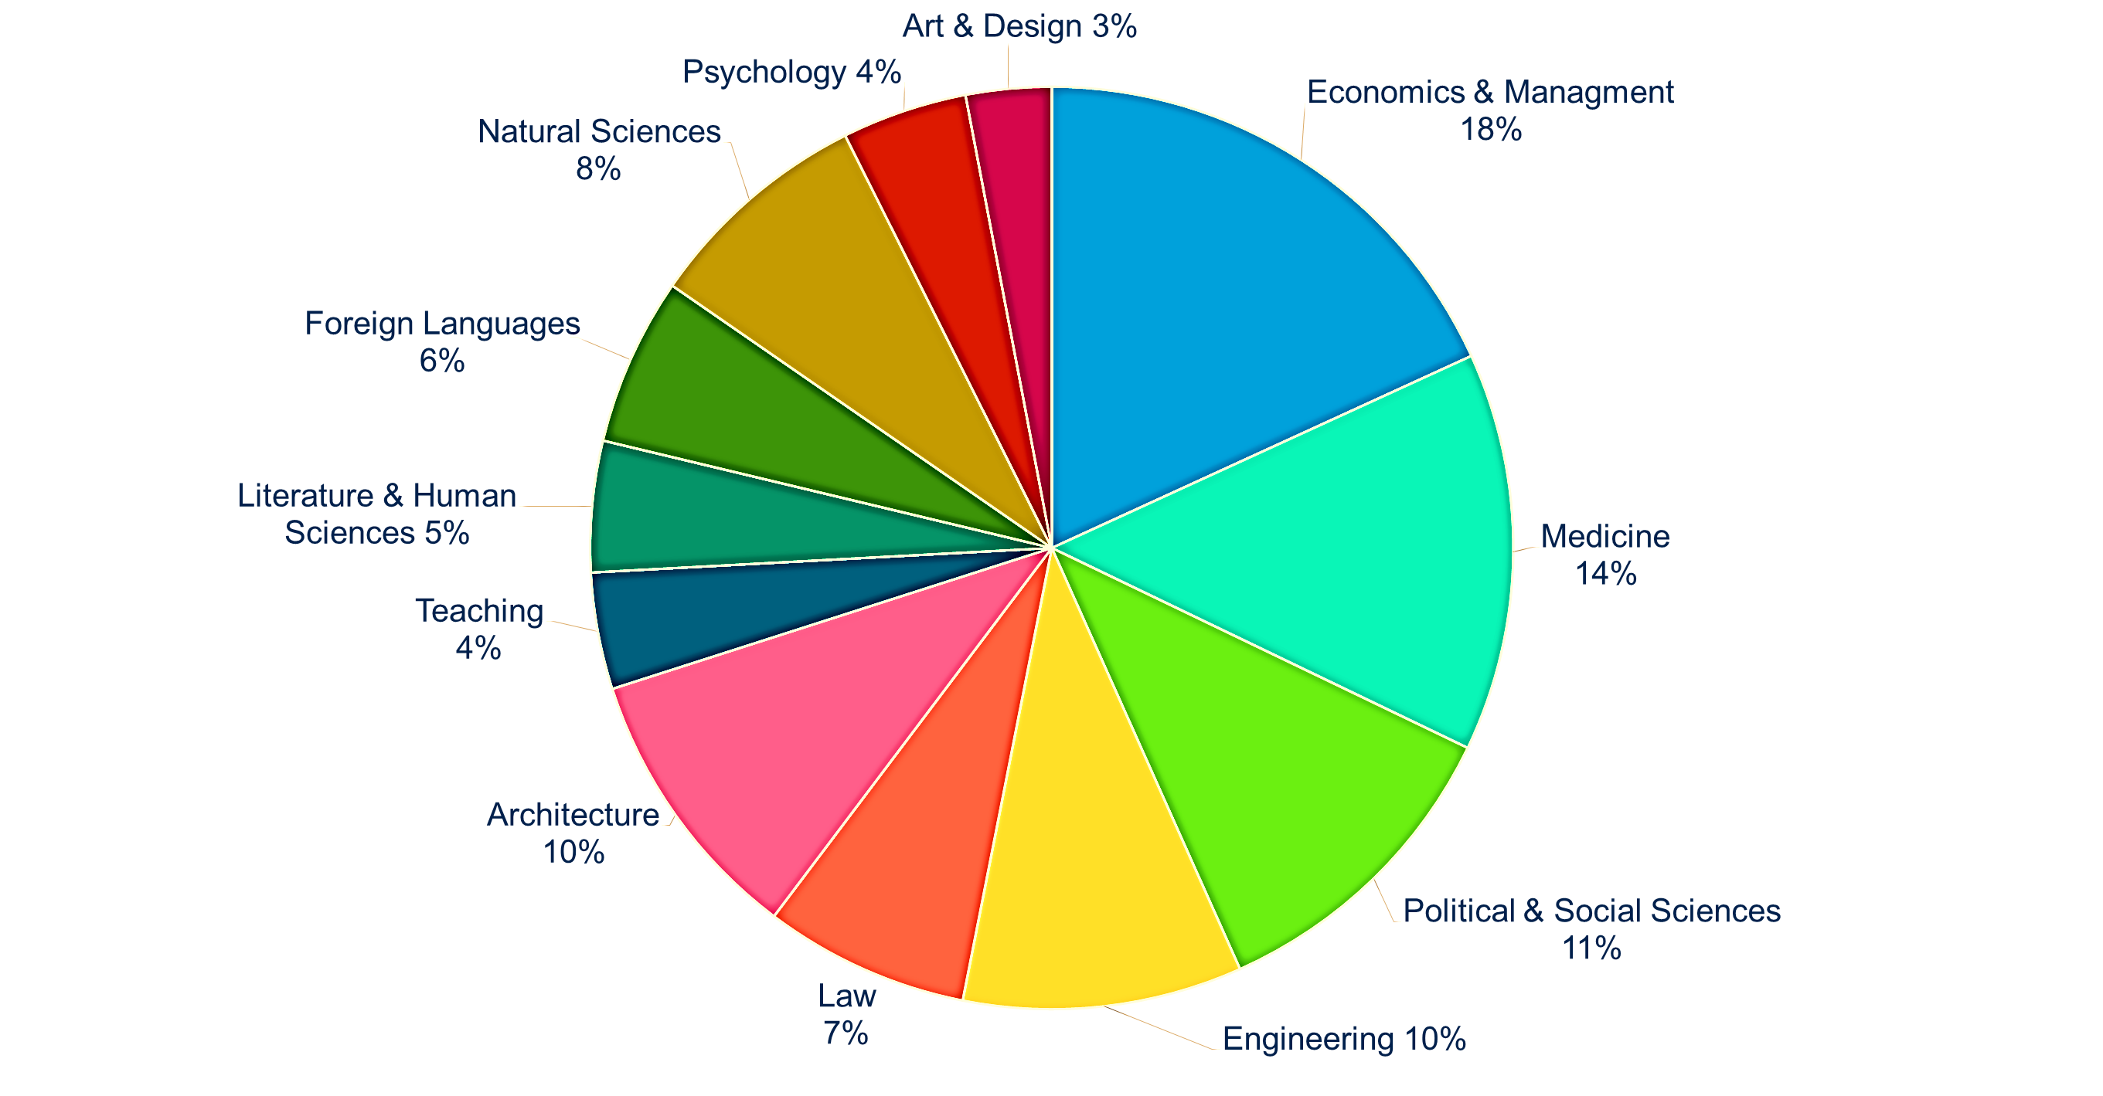


LAZIO,
REGION OF KNOWLEDGE
GRADUATES BY SUBJECT
LAZIO IS A TERRITORY RICH IN ADVANCED EDUCATIONAL OFFER AND HUMAN CAPITAL.
IT IS AMONG THE FIRST ITALIAN REGIONS FOR NUMBER OF RESEARCHERS, UNIVERSITIES AND PUBLIC AND PRIVATE RESEARCH INSTITUTIONS.
LAZIO IS ALSO ONE OF THE MOST SIGNIFICANT RESEARCH HUB IN EUROPE.
41
Universities
6 Public
13 Private
11 Distance Learning Universities
11 Pontifical Colleges
353.953
54.244
University Students
Graduates
29.886 Female
24.358 Male
11.926
60%
15.651
Phd Graduates
University Professors and Researchers
Graduates in science and economic
Notes:
INGRANDITO GRAFICO A TORTA CON I LAUREATI PER DISCIPLINA - non risultava leggibile
RIVEDERE INFOGRAPH
Dati aggornati

Slide 11





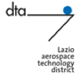





SECTOR OF EXCELLENCE
AEROSPACE AND SECURITY
23.500
360+
LAZIO PLAYS A SIGNIFICANT INTERNATIONAL ROLE IN THE INDUSTRY OF AEROSPACE, AERONAUTICS, SPACE ECONOMY AND SECURITY, BOTH IN THE MANUFACTURING INDUSTRY AND FOR SPECIFIC SKILLS IN TECHNOLOGICAL SERVICES AND R&D
EMPLOYEES
COMPANIES
2 BN EURO
5 BN EURO
IN EXPORTS
ANNUAL TURNOVER
Lazio is the only Italian Region which hosts the whole aerospace value chain. Important big groups of international excellence in electronics, sensors, avionics, components and innovative materials, “space” and satellite applications and services, are located in the Region.
4
12
LAZIO AEROSPACE TECHNOLOGICAL DISTRICT (DTA) was established in 2004 by a Framework Agreement signed by Italy Ministry of Research and Lazio Region. In 2012, the DTA of Lazio was one of the founding partners of the Italian National Cluster for Aerospace Technological (CTNA).
ESA BIC (Business Incubation Centre) Lazio is a partnership among Lazio Region, ASI (Italian Space Agency) and ESA (European Space Agency).
FACULTiES OF ENGINEERING
UNIVERSITY DEPARTMENTS
30
3.000
POST-DEGREE UNIVERSITY COURSES
RESEARCHERS
Notes:
Ok fs

Slide 12
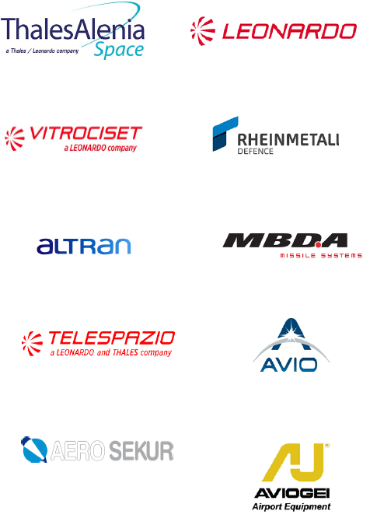
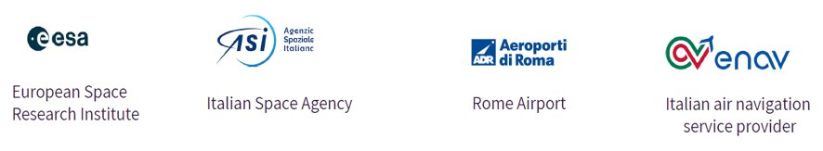








BUSINESS ENVIRONMENT
AEROSPACE AND SECURITY
BIG CORPORATES
R&D NETWORK AND
BIG PUBLIC PLAYERS
12
Telecommunication, Remote
Sensing, Earth Observation​
Notes:
COSA ì IL 19 sopra il disegnino???

Slide 13









SECTOR OF EXCELLENCE
LIFE SCIENCES
+300
Lazio is the 2nd Italian hub and one of the most important in Europe for the life sciences industry, with RELEVANT international players and highly innovative local SMEs LINKED with the NATIONAL public research network.
COMPANIES
9 BN EURO
8 BN EURO
ANNUAL TURNOVER
EXPORTS
LAZIO HEALTH TECHNOLOGICAL CLUSTER (DTB) was established in 2008 and is one of the founding members of the Italian National Technological Cluster of Life Sciences ALISEI.
MAIN SPECIALIZATIONS
Pharmaceutical innovative drugs
New vaccines (one of the most effective anti-Ebola vaccines is from Lazio) and biomedical production
Pre-clinical development of inhibitors for the treatment of solid cancers
E-Health
Medical devices.
22,000
10,000
EMPLOYEES
RESEARCHERS
26
8
SPECIALIZED RESEARCH CENTRES
UNIVERSITIES WITH BIOMEDICINE DEPARTMENTS
Notes:
Ok fs

Slide 14
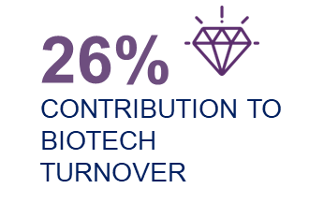


SECTOR OF EXCELLENCE
BIOTECH
70
LAZIO IS THE SECOND REGION IN TERMS OF NUMBER OF BIOTECH COMPANIES AND TURNOVER IN ITALY. OVER THE LAST FIVE YEARS,
LAZIO HAS RECORDED AN INCREASE IN ITS SHARE FROM 17% TO 21% IN TERMS OF INVESTMENTS IN BIOTECH
BIOTECH COMPANIES (ABOUT 10% OF THE NATIONAL TOTAL)
Over the last years, BIOTECHNOLOGY has expanded to include new and diverse sciences, such as GENOMICS, RECOMBINANT GENE techniques, applied IMMUNOLOGY, and development of PHARMACEUTICAL therapies and DIAGNOSTIC TESTS. It includes also the commitment to health to create vaccines, such as that against Covid-19.
THE BIOTECHNOLOGY INDUSTRY IN ITALY:
• a growing and research-intensive sector
• the growth trend continues for all the main indicators
• biotech is characterized as one of the main national science-based sectors
• biotechnologies are an innovative lever for the bio-economy and sustainable economic development.
2.7 BN EURO
BIOTECH TURNOVER
2.200
2.075
BIOTECH EMPLOYEES
BIOTECH RESEARCHERS
Notes:
Ok fs
INSERIRE «SETTORE» PHARMA

Slide 15




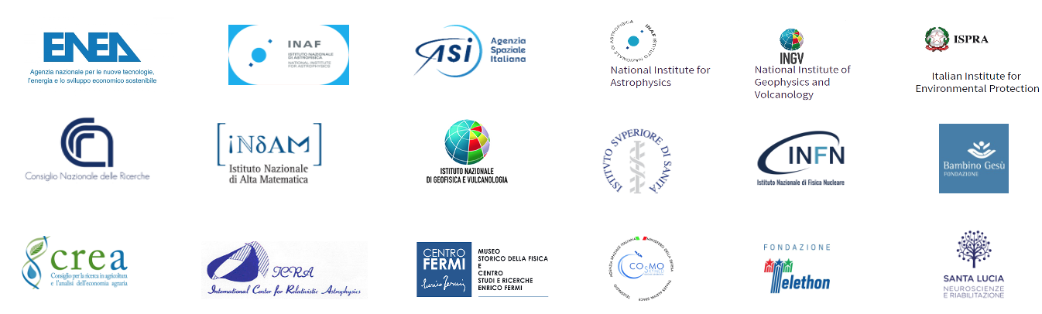












BUSINESS ENVIRONMENT
LIFE SCIENCES
CORPORATES
R&D NETWORK AND
BIG PUBLIC PLAYERS
Notes:
Ok fs

Slide 16





SECTOR OF EXCELLENCE
TOURISM
LAZIO IS ONE OF THE MOST IMPORTANT ITALIAN DESTINATIONS IN TERMS OF NATIONAL AND INTERNATIONAL TOURISM, WITH ROME HAVING THE HIGHEST MARKET SHARE FOR TOTAL TOURIST NUMBERS IN ITALIAN CITIES.
5,1 MN
20,5 MN
+3,7 BN EURO
The number of tourists in Lazio in 2022 reached approximately 9.3 million, foreigners totaled 5.3 million. In 2023, tourist presences further intensified.
FOREIGN TOURIST ARRIVALS
FOREIGN OVERNIGHT STAYS
TOURIST SPENDING RELATED TO THE CULTURAL AND CREATIVE INDUSTRY
THE OFFICIAL TOURIST BOARD OF LAZIO REGION:
https://www.visitlazio.com/web/en/
30.000
7,7 BN EURO
4
CULTURAL TOURISM COMPANIES
THE AMOUNT SPENT BY FOREIGN TOURISTS
NIGHTS IS THE AVERAGE STAY
Notes:
ok fs
NUOVO TESTO:
The number of Italian tourists in Lazio in 2022 reached approximately 9.3 million (4.4 million in 2021), foreigners totalled 15.3 million (2.3 million in 2021). In the first four months of 2023, tourist presences further intensified.
Dati da aggiornare!!

Slide 17



SECTOR OF EXCELLENCE
CULTURE TECH ​
LAZIO IS THE FIRST ITALIAN REGION FOR ADDED VALUE AND EMPLOYMENT PRODUCED BY THE CULTURAL AND CREATIVE PRODUCTION SYSTEM, WITH ROME AS THE GREATEST CONTRIBUTOR TO THE EXCELLENCE OF THE REGION.
197.000
€ 14.7 BN
25 MN
THE LAZIO CULTURE TECHNOLOGY DISTRICT (DTC) contributes to the development of the cultural industry, increasing synergy among universities, culture and production in knowledge, conservation, restoration, valorization and use of cultural heritage.
EMPLOYEES
ADDED VALUE OF THE SECTOR
VISITORS OF MUSEUMS
AND ARCHEOLOGICAL SITES
MAIN SPECIALIZATIONS:
Advanced immersive technologies, Augmented reality combined with storytelling techniques, Conservation of archeological Heritage, Video Game Industry, Digital technologies for cinema, 3D animation, Photography, Television, Music, Theatre, Publishing, Utilities and applications on digital platforms.
8%
34.150
30.000
COMPANIES
COMPANIES LINKED TO CULTURAL TOURISM
CONTRIBUTION TO REGIONAL GDP
Notes:
Ok fs

Slide 18
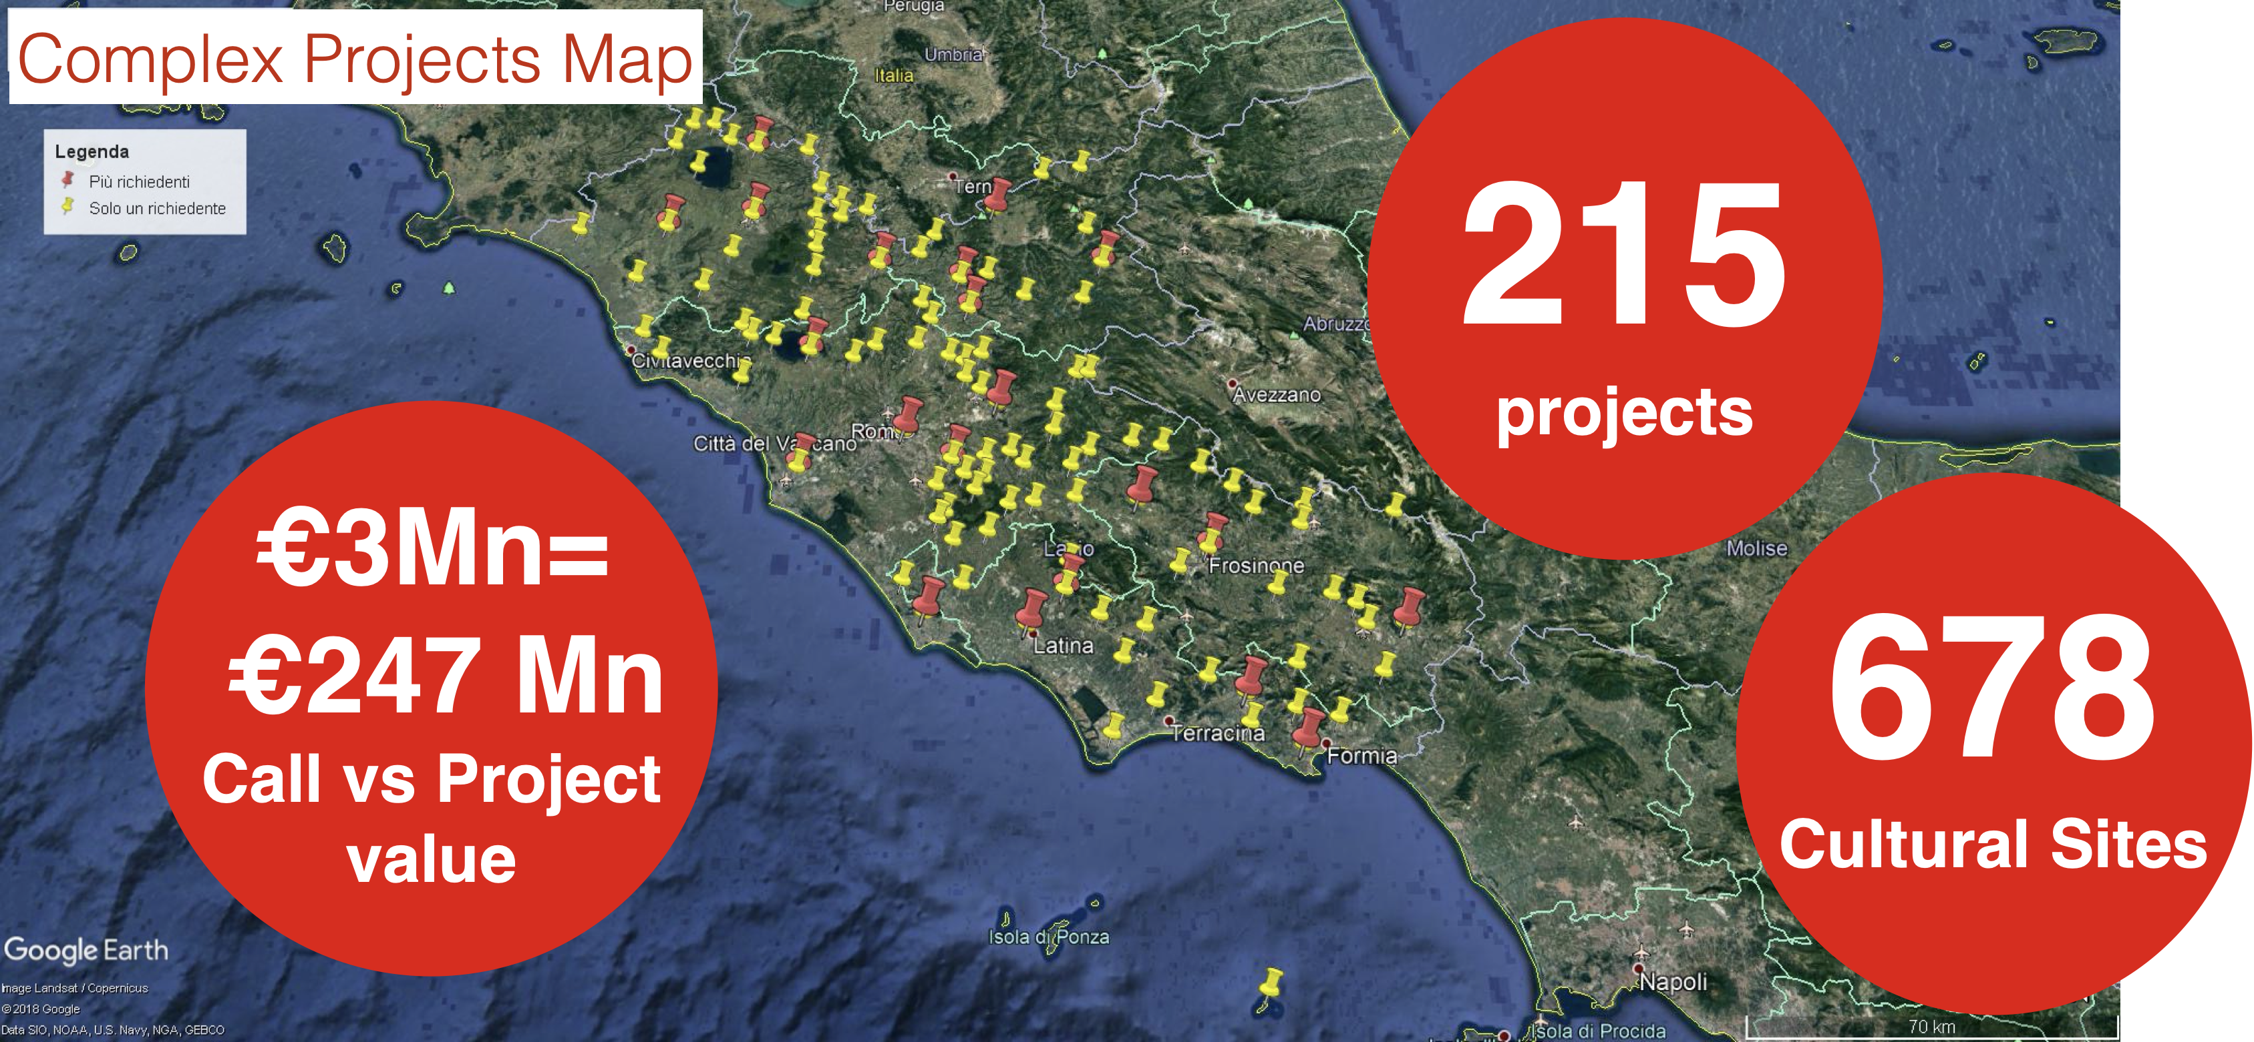

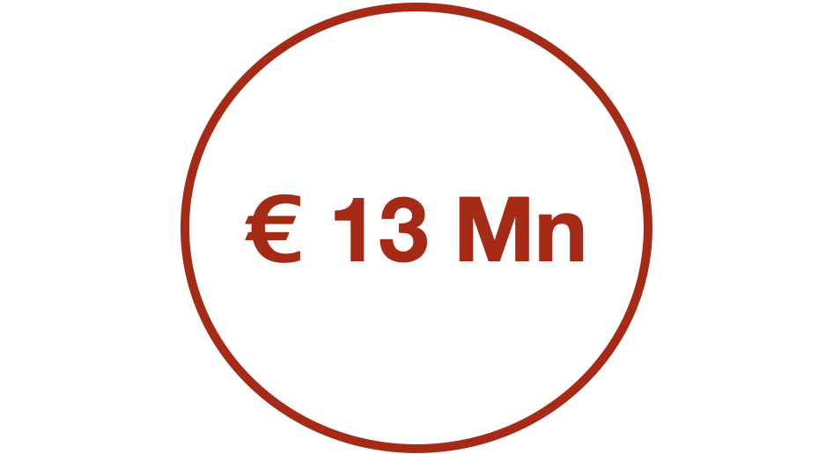
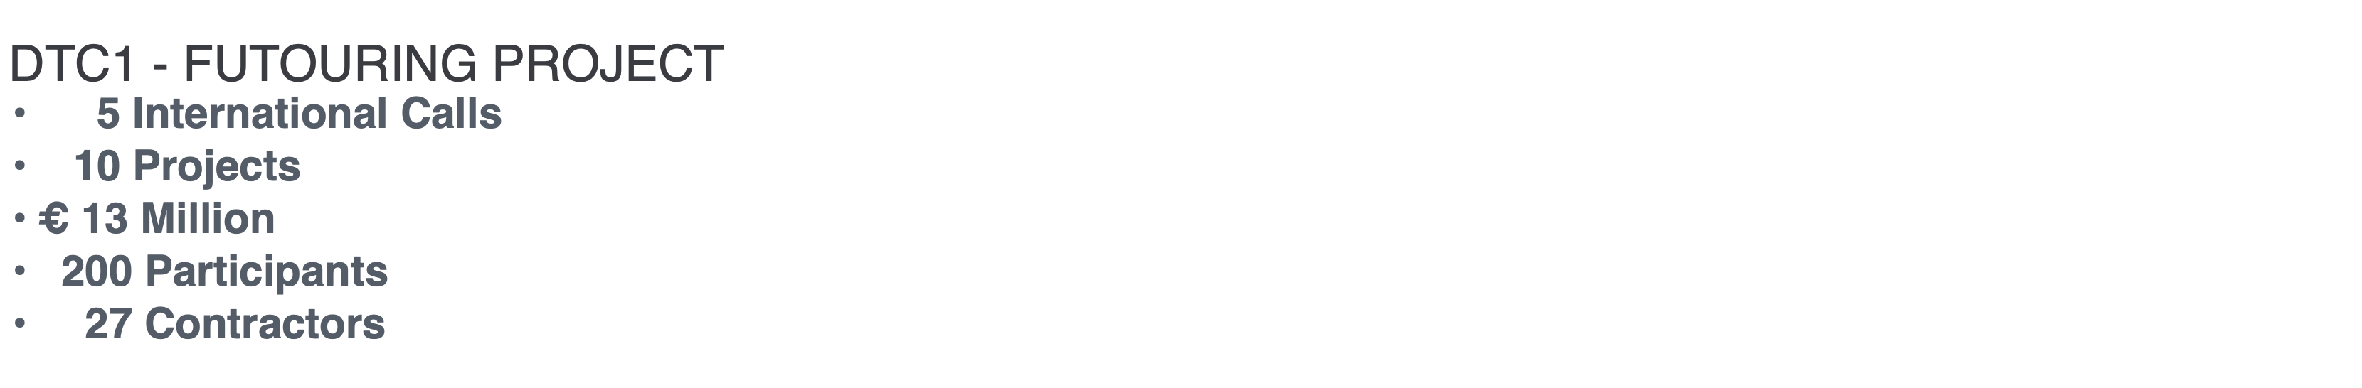
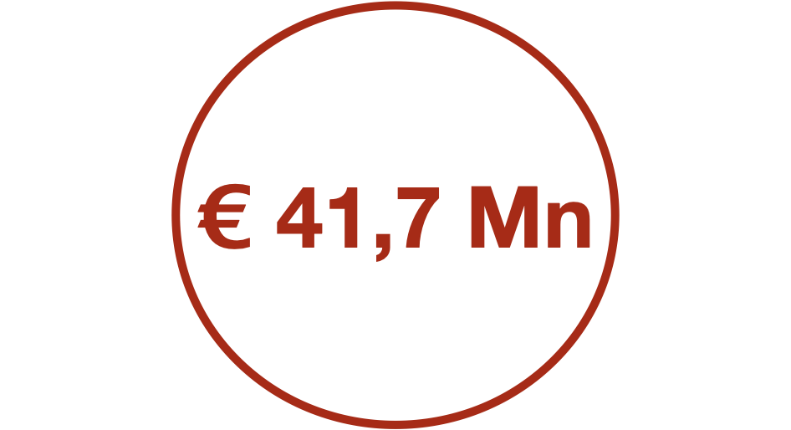
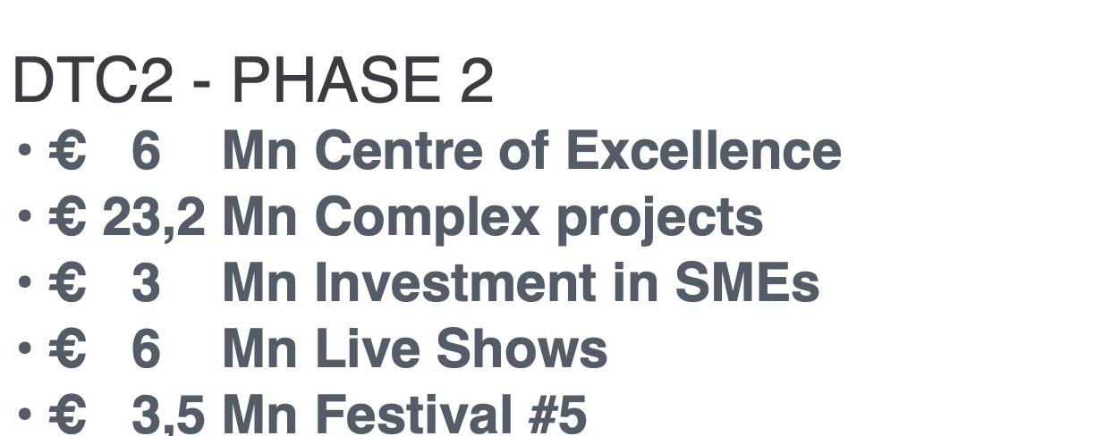
SECTOR OF EXCELLENCE
THE CULTURAL HERITAGE TECH DISTRICT
The "Cultural Heritage and Culture Technologies" Specialisation Area - with the inclusion of related technologies and applications - has a consolidated academic, scientific and business tradition in Lazio.
It is a sector of excellence in the region, recognized all over the world and which boasts over 165 museums (state, civic, provincial), 17 amongst universities, central institutes and research organizations and over 30,000 businesses linked to the culture and tourism value chain.
Notes:
Ok fs

Slide 19



SECTOR OF EXCELLENCE
AUDIOVISUAL AND FILM INDUSTRY
IN THE AUDIOVISUAL SECTOR, LAZIO HOLDS A CONSOLIDATED LEADERSHIP AT NATIONAL LEVEL. IN ADDITION, ITS SUPPLY CHAIN IS A DRIVING FORCE.
27.000
50%
The audiovisual core of Lazio is concentrated in ROME, also thanks to the presence of CINECITTA’ FILM STUDIOS.
EMPLOYEES
WEIGHT OF THE SECTOR AT NATIONAL LEVEL
Lazio Region supports numerous initiatives such as the Roma Lazio Film Commission and the Rome Film Fest (RFF).
Today Lazio Region is the second in Europe in terms of investments in the sector after Berlin-Brandenburg.
4.381
2.200
AUDIOVISUAL AND
MUSIC COMPANIES
FILM COMPANIES
  MAIN SPECIALIZATIONS
93%
Film, Video, Radio-TV Industry, Animation and 3D Animation, Advertising, Digital effects for the Cinema and Music Videos.
COMPANIES IN ROME
Notes:
Ok fs

Slide 20
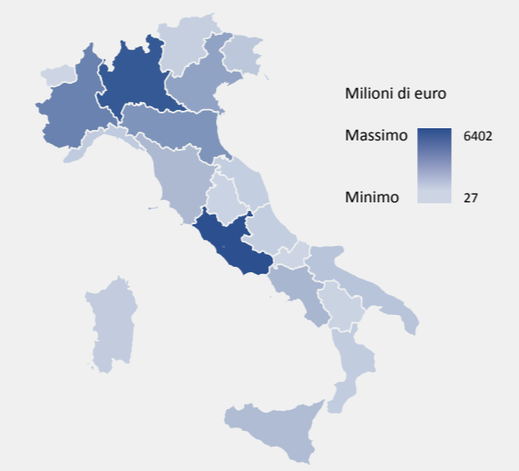
SECTOR OF EXCELLENCE
ICT
ICT sector PLAYS A SIGNIFICANT ROLE IN THE STRATEGIC development OF Lazio REGION.
Rome HOSTS almost all ICT companies of THE REGION and shares with Milan the record of having the HIGHEST concentration of ICT companies in Italy.
The sector has the highest employment impact on the REGION.
700 MN Euro
In 2019, Lazio ranked first in Italy in terms of ICT spending with more than 20% of the national ICT spending.
INVESTMENT IN ICT
6,5 BN Euro
ICT spending
  MAIN SPECIALIZATIONS
80.000
Digital Transformation, Cloud Computing, Mobility, Social, Business, Big Data and Analytics, Smart cities.
EMPLOYEES
Notes:
Ok fs

Slide 21

SECTOR OF EXCELLENCE
ENGINEERING & AUTOMOTIVE
LAZIO BOASTS AN EXTREMELY IMPORTANT AND CONSOLIDATED AUTOMOTIVE SECTOR. THE REGIONAL ENGINEERING INDUSTRY CONSISTS OF HUNDREDS OF SMEs LINKED TO THE FULL SUPPLY CHAIN, IN PARTICULAR TO COMPONENTS PRODUCTION.
Particularly important is the concentration of companies of the automotive supply chain in the industrial area of ​​Cassino (Frosinone). The development of this strategic area began in 1972 with FIAT. The site, which covers an area of over 2 million square meters, is the largest FCA plant in Italy, only equal to the Mirafiori site in Turin.
29.000
1.5 BN Euro
EMPLOYEES
IS THE VALUE OF EXPORT
7.800
MAIN SPECIALIZATION
COMPANIES LINKED
TO THE SECTOR
Motor vehicles, sports vehicles, light commercial vehicles, heavy commercial vehicles, buses, agricultural vehicles, earth moving machines. Industrial automation, mechanical processing, electronics, mold construction, in plastic molding, painting and consequential logistics services.
Notes:
Ok fs

Slide 22





SECTOR OF EXCELLENCE
AGRIFOOD
  Lazio Region is one of the top players in Europe for the marketing of fruit and vegetable products.
MAJOR LOGISTIC PLATFORMS:
Agribusiness Centre of Rome (CAR)
FONDI Fruit and Vegetable Market (MOF)
Fruit and Vegetable Market of Latina (MOL)
3.400
20.000
110
COMPANIES
EMPLOYEES
NUMBER OF COMPANIES MARKETING TRADITIONAL PRODUCTS DERIVING FROM REGIONAL AGRICULTURAL BIODIVERSITY RESOURCES
THE LAZIO AGRIFOOD SYSTEM INTEGRATES ALSO TECHNOLOGICAL CONTENTS FROM OTHER SECTORS SUCH AS AEROSPACE (i.e. climate change observation, land surveys to prevent flooding), ICT, NANOTECHNOLOGIES, NEW MATERIALS AND BIOTECHNOLOGIES.
40
6.3 BN Euro
770 MN Euro
CERTIFIED QUALITY LABELS
(DOP, IGT, IGP, DOC E DOCG)
Annual turnover
EXPORT
Notes:
Ok fs

Slide 23

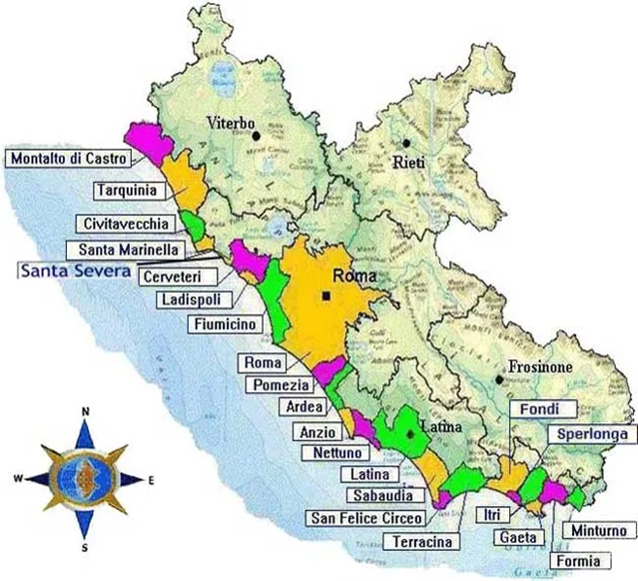

SECTOR OF EXCELLENCE
BLUE ECONOMY
Blue Economy covers all economic activity That take place in or result from our oceans, seas and coasts.
THE World Bank defines the blue economy AS "sustainable use of ocean resources for economic growth".
Lazio Innova is a founding member, on behalf of the Lazio Region, of the National Technological Cluster "Blue Italian Growth".
148.200
35.000
EMPLOYEES
COMPANIES
Blue economy includes the following sectors:
Aquaculture and fishing
Marine mining industry
Ship building industry
Marine transport
Marine coastal and tourism
Research, regulation and environmental protection activities
Sports and recreational activities.
383 KM
8.1 BN Euro
SEA COASTLINE
VALUE ADDED OF THE SECTOR
Notes:
Ok fs – apportato piccole modifiche grafiche per rendere la mappa con i comuni del mare leggibile
Da DA RIVEDERE INFOGRAPH

Slide 24
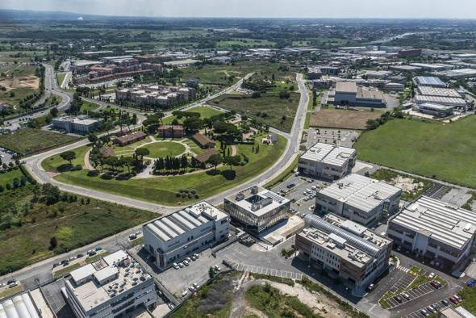
BUSINESS ENVIRONMENT
Tiburtino Technology Park - TECNOPOLO SpA
THE TIBURTINO TECHNOLOGY PARK MAINLY HOSTS SMEs, STARTUPS AND RESEARCH CENTERS OPERATING IN THE AERSOPACE, ELECTRONICS AND DEFENSE SECTORS.
IT IS PART OF TECNOPOLO SPA, A PUBLIC COMPANY CREATED IN 1995 WITH THE AIM TO PROMOTE AND IMPROVE THE LOCATION AND DEVELOPMENT OF HIGH-TECH AND INNOVATIVE INITIATIVES.
AEROSPACE & DEFENCE
COMPANIES
Presence of key players of the Aerospace and Defense industry
Innovative infrastructures and services
Strong links with Universities and Research
ADPM DRONES S.R.L.
ACMECUBO SRL
ATEN IS SRL – RETE DI IMPRESE
BLUE THREAD S.R.L.
DEFENCE TECH HOLDING
DELTA SPACE LEONIS SRL
GEMAC ENTERPRIOSES NETWORK
HTT – HIGH TECHNOLOGY TRANSFORMERS S.R.L.
IN QUATTRO SRL
INTECH MICROWAVES S.R.L (IMW)
IRS ITALIAN REMOTE SENSING SRL
MIPRONS SRL
NG DETECTORS SRL
PROSER S.R.L.
PSI PROGETTI SPECIALI ITALIANI S.R.L.
SDS S.R.L.
SIGMA CONSULTING S.R.L.
SPACEEXE S.R.L.
WAVE ADVANCED TECHNOLOGY APPLICATIONS S.R.L.
70
150
HECTARES
COMPANIES
Notes:
Ok fs
Controlla aziende tecnopolo se rimaste invariate
ACMECUBO S.r.l.
Settore: Aerospazio e Space Economy - ICT, Elettronica e Telecomunicazioni - Innovazione, Ricerca e Trasferimento Tecnologico
Tiburtino
ADPM DRONES S.r.l.
Settore: Aerospazio e Space Economy
Tiburtino
ATEN IS S.r.l. – RETE DI IMPRESE
Settore: Aerospazio e Space Economy
Tiburtino
BLUE THREAD S.r.l.
Settore: Aerospazio e Space Economy
Tiburtino
DEFENCE TECH HOLDING
Settore: Aerospazio e Space Economy - ICT, Elettronica e Telecomunicazioni
Tiburtino
Delta Space Leonis S.r.l.
Settore: Aerospazio e Space Economy
Tiburtino
GEMAC ENTERPRISE NETWORK
Settore: Aerospazio e Space Economy
Tiburtino
HTT – HIGH TECHNOLOGY TRANSFORMERS S.r.l.
Settore: Aerospazio e Space Economy
Tiburtino
IN QUATTRO S.r.l.
Settore: Aerospazio e Space Economy
Tiburtino
INTECH MICROWAVES S.r.l. (IMW)
Settore: Aerospazio e Space Economy
Tiburtino
IRS Italian Remote Sensing S.r.l.
Settore: Aerospazio e Space Economy
Tiburtino
Miprons S.r.l.
Settore: Aerospazio e Space Economy
Tiburtino
NG DETECTORS S.r.l.
Settore: Aerospazio e Space Economy
Tiburtino
PROSER S.r.l.
Settore: Aerospazio e Space Economy
Tiburtino
PSI PROGETTI SPECIALI ITALIANI S.r.l.
Settore: Aerospazio e Space Economy
Tiburtino
SDS Systems Development & Support S.r.l.
Settore: Aerospazio e Space Economy
Tiburtino
SIGMA CONSULTING S.r.l.
Settore: Aerospazio e Space Economy
Tiburtino
SPACE EXE S.r.l.
Settore: Aerospazio e Space Economy
Tiburtino
WAVE ADVANCED TECHNOLOGY APPLICATIONS S.r.l.
Settore: Aerospazio e Space Economy

Slide 25
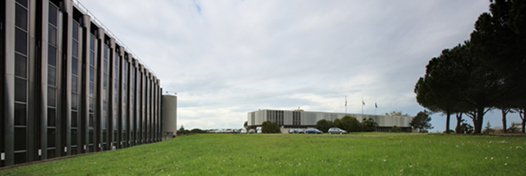
BUSINESS ENVIRONMENT
Castel Romano Technology Park - TECNOPOLO SpA
CASTEL ROMANO TECHNOLOGY PARK IS ONE THE MAIN ITALIAN CENTERS FOR APPLIED RESEARCH AND A FIRST-CLASS LOCATION FOR BUSINESS, IT IS CONNECTED TO THE MOST QUALIFIED NATIONAL AND INTERNATIONAL PARTNERS FOCUSED ON HEALTH, BIOTECHNOLOGY, LIFE SCIENCES, INNOVATION, RESEARCH AND TECHNOLOGY TRANSFER, NEW MATERIALS AND ADVANCED MANUFACTURING, ENVIRONMENT AND GREEN ECONOMY.
IT IS PART OF TECNOPOLO S.P.A., A PUBLIC COMPANY CREATED IN 1995 WITH THE AIM TO PROMOTE AND IMPROVE THE LOCATION AND DEVELOPMENT OF HIGH-TECH AND INNOVATIVE INITIATIVES
Presence ok key players: companies, laboratories and research centers.
Innovative infrastructures and services for the new materials and advanced manufacturing
Strong links with universities and research
COMPANIES
AND RESEARCH CENTRES:
52
400
HECTARES
PEOPLE INVOLVED
EVVIVAX SRL
EXIRIS SRL
NEOMATRIX SRL
PLAISANT SRL
REITHERA S.R.L.
TAKIS S.R.L.
TESTING POINT 5 S.R.L
VITARES
Notes:
Ok fs
Tecnopolo Roma Castel Romano constitutes one of the engines of Italian research applied to industry; a place to open and develop the dialogue between scientific and business culture. More than 300 people including technicians, researchers and professionals carry out their activities within an area that is increasingly qualifying nationally and internationally as a reference pole of the fields of Health, Biotechnology and Life Sciences, Innovation, Research and Technology Transfer, New Materials and Advanced Manufacturing and Environment and Green Economy, through the presence of important companies, laboratories and research centers.
Controlla aziende tecnopolo se rimaste invariate
ALMASEARCH S.r.l.
Settore: Health, Biotecnologie e Scienze della Vita
Castel Romano
EVVIVAX S.r.l.
Settore: Health, Biotecnologie e Scienze della Vita
Castel Romano
EXIRIS S.r.l.
Settore: Health, Biotecnologie e Scienze della Vita
Tiburtino
GRUPPO MC VEICOLI SPECIALI S.r.l.
Settore: Health, Biotecnologie e Scienze della Vita - Meccanica e Impiantistica
MBS S.r.l.- MICRO BIOLOGICAL SURVEY
Settore: Health, Biotecnologie e Scienze della Vita
Tiburtino
MEDLOGIX S.r.l.
Settore: Health, Biotecnologie e Scienze della Vita
Castel Romano
NEOMATRIX S.r.l.
Settore: Health, Biotecnologie e Scienze della Vita
Tiburtino
NV LAB S.r.l. – Gruppo Grezzo Raw Chocolate
Settore: Health, Biotecnologie e Scienze della Vita
Castel Romano
PLAISANT S.r.l.
Settore: Health, Biotecnologie e Scienze della Vita
Castel Romano
REITHERA S.r.l.
Settore: Health, Biotecnologie e Scienze della Vita - Innovazione, Ricerca e Trasferimento Tecnologico
Tiburtino
RIGEL S.p.A.
Settore: Health, Biotecnologie e Scienze della Vita - Servizi alle Imprese
Tiburtino
T.F.I. SYSTEM S.r.l.
Settore: Health, Biotecnologie e Scienze della Vita
Scopri di più
Castel Romano
TAKIS S.r.l.
Settore: Health, Biotecnologie e Scienze della Vita
Scopri di più
Castel Romano
TESTING POINT 5 S.r.l.
Settore: Health, Biotecnologie e Scienze della Vita
Scopri di più
Castel Romano
VITARES – APS
Settore: Health, Biotecnologie e Scienze della Vita
Scopri di più
Tiburtino
VIVITA pharma S.r.l.
Settore: Health, Biotecnologie e Scienze della Vita

Slide 26
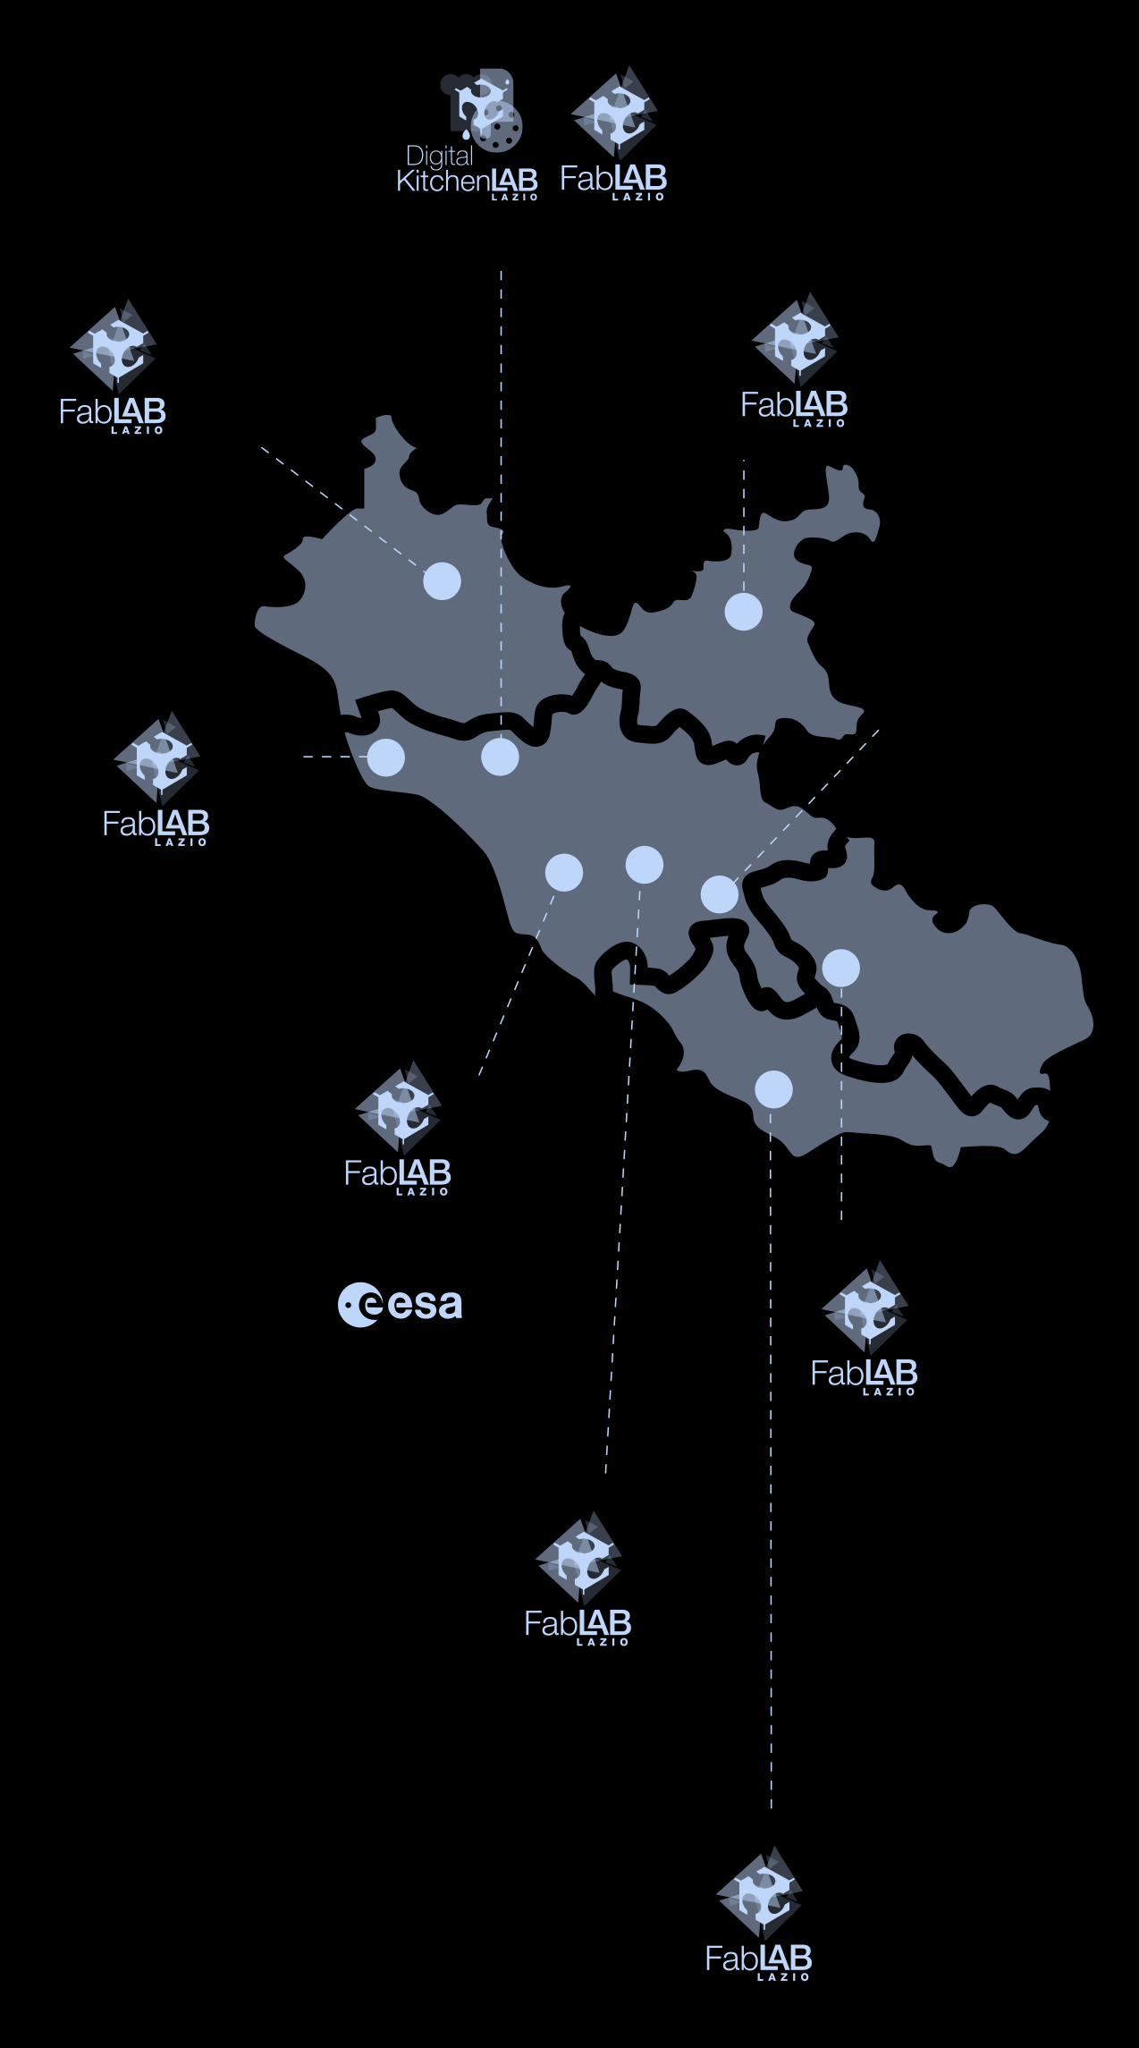
BUSINESS ENVIRONMENT
BRACCIANO
Agri-food and forestry systems
VITERBO
Creative and cultural industries
RIETI
Electronics and environmental sustainability
INNOVATION HUBS
“SPAZI ATTIVI” are hubs where citizens, startups, businesses and local authorities can gather and contribute to the growth of the territory. All services are offered with an aim to promote and generate innovation, assist development, creativity and dissemination of business culture
THERE ARE 10 “SPAZI ATTIVI” IN LAZIO, EACH ONE OF THEM IS CHARACTERIZED BY A MAIN AREA OF SPECIALISATION:
CIVITAVECCHIA
Tourism and economies of the sea
COLLEFERRO
Energy efficiency
and environmental sustainability
ROME
Casilino: Fashion and Design
TECNOPOLO:
Space technology applications
Roma Casilina, Fashion And Design
Roma Tecnopolo, Applications Of Space Technologies
Viterbo, Cultural And Creative Industry
Rieti, Electronics And Environmental Sustainability
Bracciano, Agrifood And Forestry Systems
Ferentino, Mechanics And Automation Systems
Colleferro, Energy Efficiency And Environmental Sustainability
Latina, Life Sciences And Blue Growth
Civitavecchia, Tourism
Zagarolo, Game, Culture And Tourism
FERENTINO
Mechanics and
automation systems
ZAGAROLO
Open Innovation Centre
LATINA
Life Sciences and economies of the sea
Notes:
Ok fs

Slide 27
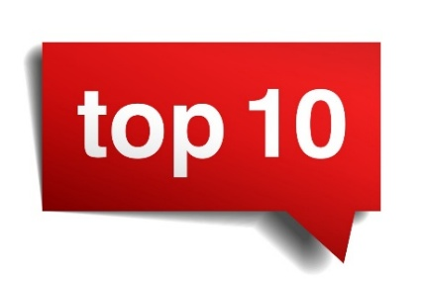
REASONS WHY TO CHOOSE LAZIO
Competitiveness
  Italy: Access to unique expertise in leading sectors such as machinery, robotics, design, pharmaceuticals, fashion, and food
    Extensive networks of SMEs and manufacturing clusters throughout the country
  Lazio: 2nd Italian region for innovative startups
    Main products exported: pharmaceuticals (47% of total), vehicles (10% of total), chemicals, metals, textiles, machinery, electronics, and food
Skilled workforce and Talent pool
  Italy: Skilled workforce with better cost performance compared to comparable European partners
  Lazio: Abundance of human capital, researchers, 19 universities, and public/private institutions
    One of the most significant research centers in Europe
R&D and innovation
  Italy: Research and innovation integrated into industrial processes, excellence in various fields
  Lazio: Industrial leader, excellence in research, innovation, and skills in leading sectors globally
Quality of life and cultural offer
  Italy: Ancient monuments, art, culture, music, food, and quality goods
  1st worldwide for UNESCO World Heritage, over 50 million international tourist arrivals annually
  Lazio: Some of the most important monuments in the world, 6 UNESCO sites
  Rome as one of the world's most famous destinations with unique artistic and cultural heritage
Pro investment incentives
  Italy: Integrated system of financial incentives and fiscal benefits to create a favorable environment for industrial investments
  Lazio: Regional instruments in addition to national incentives
  Settlement and development agreements, support for research, innovation, and development projects
Public support to foreign investors: national and local
  INVEST IN ITALY: One-stop shop for investing in Italy, providing pre-investment information, business set-up assistance, and aftercare
  INVEST IN LAZIO: One-stop shop for investing in the Lazio region: location search, business set-up assistance, regional incentives and aftercare assistance.
All Roads lead to Rome
Rome is the capital of Italy and Lazio region
Hosts 209 diplomatic missions and 85 diplomatic representations of the Vatican
Home to the Vatican City, Basilica of St. Peter, Vatican Museums, and Sistine Chapel
Headquarters of international organizations (i.e.FAO, IFAD)
2. Top economy
Italy: 8th largest world economy, 3rd largest in Europe, GDP worth 1.8 trillion
Lazio: 2nd Italian region for GDP, worth EUR 239 billion
Market opportunities with a population of over 5 million and GDP per capita of 32,440 EUR
Strong and sustainable economic growth, 1st region in Italy for employment growth and reducing greenhouse gas emissions
3. Strategic logistic hub
  Italy: Strategic gateway to 500 million consumers in the EU and 270 million in Northern Africa and the Middle East
    40 major ports and 42 airports, linking southern Europe to central and eastern Europe
  Lazio: Region of the Capital Rome, heart of Europe, and center of the Mediterranean Area
    Global geopolitical importance, 2 international airports and 1 major port
    Well-connected to Milan and Naples by highway
4. Key manufacturing player
  Italy: 2nd largest manufacturing economy in Europe, 5th largest globally, EUR 516 billion in goods exports in 2021
    18,000 enterprises in the machinery and equipment sector, ranking 1st in Europe by the number of companies
  Lazio: Highest specialization in manufacturing and high-tech knowledge-intensive sectors in Italy
    72% share of exports in global leading sectors, twice the national average (32%)

Slide 28
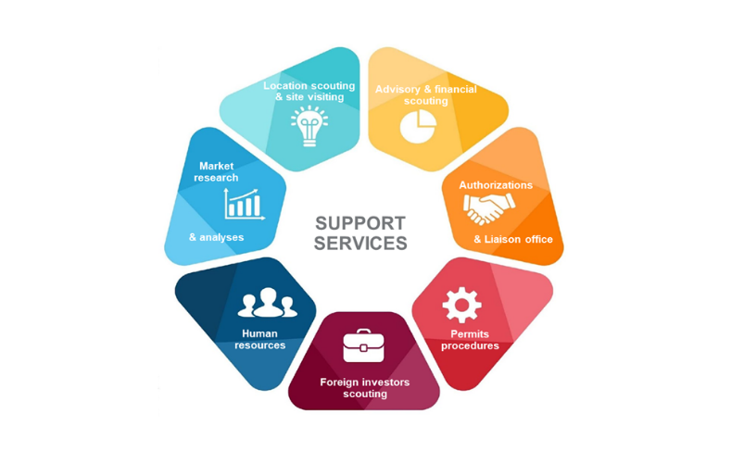
WHO –Invest in Lazio is a project dedicated to the promotion and governance of FDI - Foreign Direct Investments, which includes a coordinated program of initiatives aimed at attracting, facilitating, and retaining investment in the region, promoting Lazio as a destination for FDI (Foreign Direct Investment).
HOW –The Invest in Lazio team assists investors in the setting-up and the expansion of their operations in the region providing support and information about planning an investment in Lazio.
INVEST IN LAZIO
YOUR ACTIVE PARTNER THROUGHOUT YOUR INVESTMENT JOURNEY
Notes:
AGGIUNTO PAGINA CON WHO E HOW

Slide 29

Digital Gateway to Investment Opportunities
www.investinlazio.it
Our comprehensive digital platform, developed through FESR Lazio 2021-2027 Program resources, serves as the primary reference point for corporate and financial investors.
Comprehensive information database
Territorial opportunity showcase
Interactive ecosystem integration
Direct contact platform for investors
Personalized Services
Strategic Positioning
Tailored support for both international investors and local enterprises to generate business opportunities and drive innovation.
Integrated approach combining territorial potential valorization with targeted customer care for sustainable development.

Slide 30

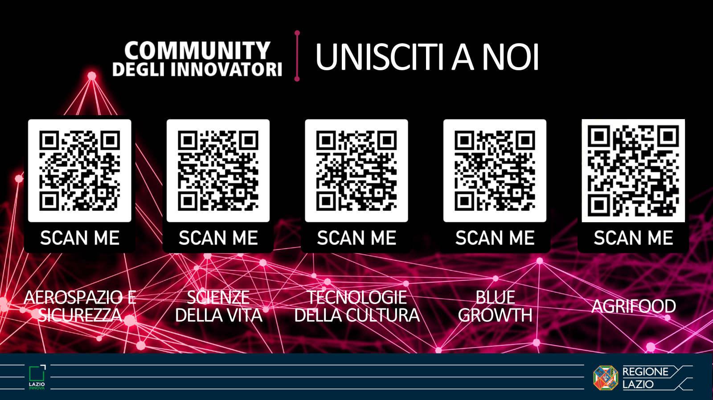
Contact us
Lazio Innova SpA - Regione Lazio
www.lazioinnova.it
www.laziointernational.it
www.regione.lazio.it
email: internazionalizzazione@lazioinnova.it
phone: (+39) 06-60.51.60
COMMUNITY OF INNOVATORS
Aerospace
Life Sciences
Culture Tech
Blue Economy
Agrifood

